Slide 1


Public Health Evidence & Intelligence:
JSNA Team
Data Visualisation
May 2023
www.hertshealthevidence.org
Notes:
Thank you for your time joining today’s PH Knowledge and Skills session.
We hope you find this a useful summary of the work of the Evidence and Intelligence staff within Hertfordshire Public Health.
We are starting with a question - ‘how do YOU use data and evidence on health and wellbeing to improve your services’. As you listen to the examples, we hope you will reflect on your projects, your teams and your stakeholders, and think about how you find data and evidence, and how you analyse and evaluate evidence to improve the services that you deliver.
We hope you will also find out about some services and opportunities that could help you which you weren’t aware of before.
--------
Hi everyone. I’m Vicki and I’m a member of the Joint Strategic Needs Assessment (JSNA) team with a joint role between Public Health Evidence and Intelligence and Community Protection. I am presenting today on how the JSNA team use data visualisation to summarise complex data and information to tell a story about a specific health topic.

Slide 2
What we are talking about today
Overview of JSNA products
Graphs and tables
Population and demographic data
Infographics
Maps
www.hertshealthevidence.org
Notes:
In today’s session we are going to cover some of the tools we use to present and visualise data within JSNA products.
We will start by giving you an overview of the variety of JSNA products we create
We will then show you how we present data through graphs and tables, including how to use confidence intervals
We will then show you some of the ways in which we use and present population and demographic data
Finally, we will show you how we use infographics and sometimes maps to tell a story of a topic

Slide 3
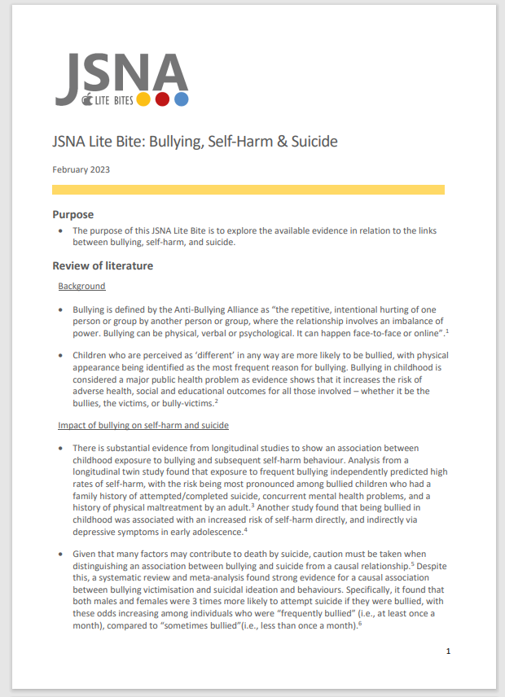
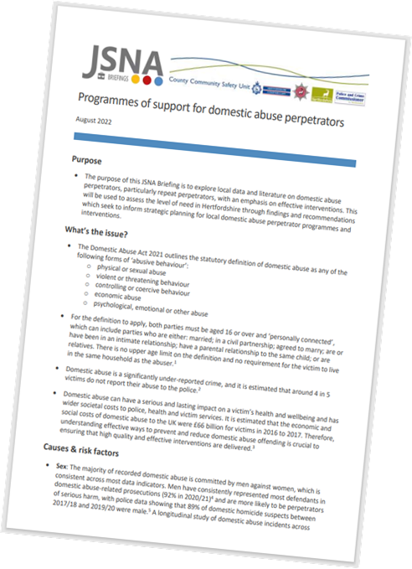

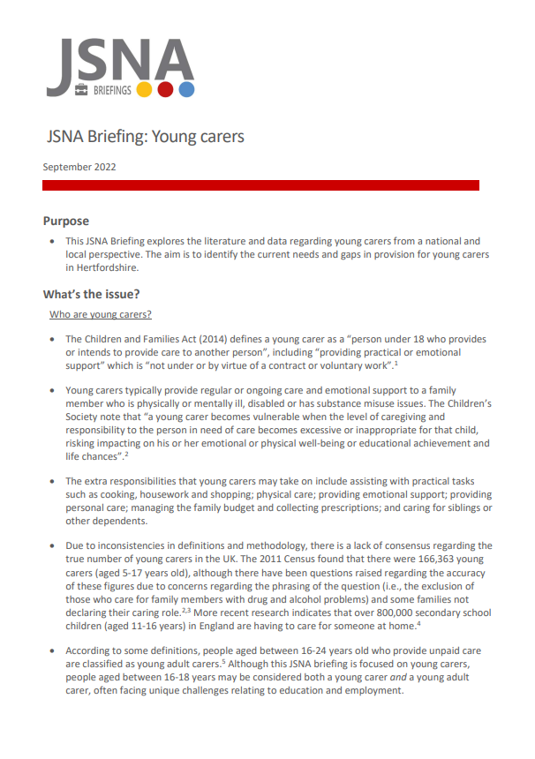
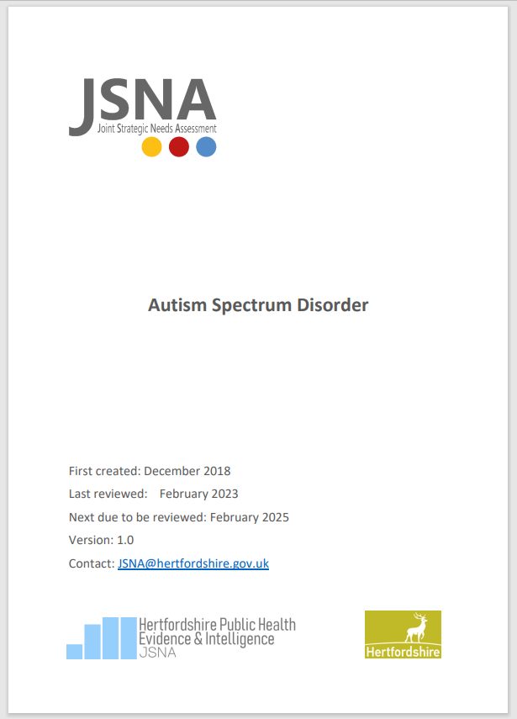
What do we do – JSNA products
JSNA products:
JSNAs
JSNA Briefings
JSNA Lite Bites
JSNA-on-a-page
(plus accessible version)
Bespoke JSNAs or larger projects (£)
www.hertshealthevidence.org
Notes:
Examples of the JSNA products we offer include the full statutory needs assessment, and JSNA briefings or rapid literature reviews known as JSNA Lite Bites for smaller topics. We also work with both internal and external stakeholders across the county on bespoke and more complex JSNA projects. The team also works on producing snapshot products such as infographics and our summary JSNA on a page documents, which we will cover in more detail in the following slides.
Our JSNA products all have a consistent format and branding which helps to easily identify the type of product. Our full JSNA documents all use an identical structure and cover page, as you can see in the example of our Autism JSNA on the slide. For our smaller products, we use a yellow strip to indicate JSNA Lite Bites, a red strip to indicate JSNA Briefings, and we use a blue strip and joint branding and logos for any needs assessments or other products that have been produced in collaboration with the County Community Safety Unit. Examples of these can be seen on the slide.

Slide 4
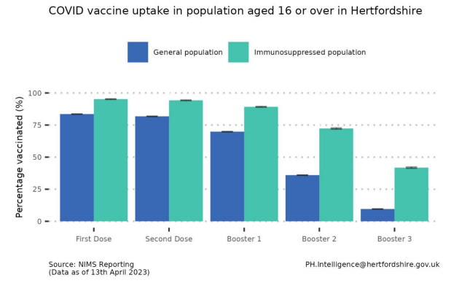
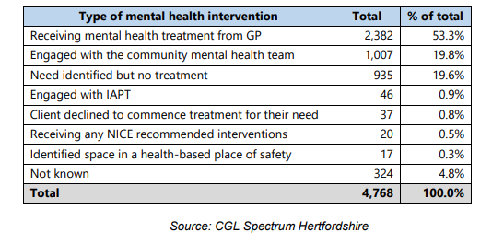
Graphs and tables
Most data and information is presented in graphs and charts
Graphs and charts help to visualise trends over time and identify differences between different areas or population groups
Using graphs allows us to add statistical significance measures
Tables are also sometimes used to show data in multiple formats or where there is a large variation in data
www.hertshealthevidence.org
Notes:
The majority of data and information in JSNA products is presented in the form of graphs and charts. This is because graphs and charts are a good visual way of showing trends over time and identifying differences between geographical areas or population groups, such as the example on the slide showing differences in uptake of COVID-19 vaccines between different populations.
Using graphs also means that we can add statistical significance measures such as confidence intervals where possible so that readers can easily identify significant differences in the data. More information on confidence intervals and how to read them is coming up on the next slide.
In some cases, we also use tables to present data where more appropriate. Tables are sometimes more appropriate to show data in more than one format (e.g. as a number, rate or percentage) or where there is a large variation between data which would be difficult to interpret on a graph, such as the example in the bottom right.

Slide 5
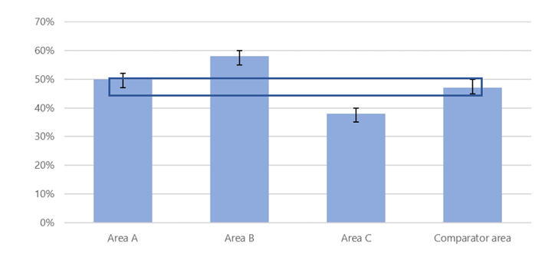
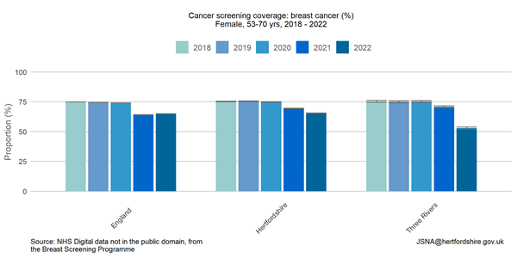
Confidence intervals
We use confidence intervals to measure statistically significant trends or differences between areas or groups
Overlapping confidence intervals mean that the data is statistically similar, whereas data that does not overlap indicates significant differences in the data (see top left example)
Example in bottom right shows that breast cancer screening coverage in Three Rivers has significantly decreased in the last 2 years and was significantly lower than Hertfordshire and England in 2022
www.hertshealthevidence.org
Notes:
Where possible on graphs, we use confidence intervals to measure statistically significant trends or differences between groups or areas. This can for example be to identify Hertfordshire districts or population groups where a particular health condition is significantly more prevalent, or to identify if there have been any statistically significant increases or decreases in a health condition over time.
Where confidence intervals overlap, this means these indicators are statistically similar, and there are no significant differences between the data. However, where confidence intervals do not overlap, this indicates that one is significantly higher or lower than the other. The graph in the top right shows an example of how to read them. In this example, Area A is statistically similar to the comparator area, due to the confidence intervals overlapping, as highlighted. On the other hand, Area B is significantly higher than the comparator area and Area C is significantly lower, as the confidence intervals do not overlap.
The second example below is taken from a Health Inequalities JSNA that we are currently working on for the Three Rivers district. The graph shows the % of breast cancer screening coverage over time for England, Hertfordshire and Three Rivers. In this example, we can see that breast cancer screening coverage in Three Rivers has decreased significantly over the last 2 years, as the confidence intervals do not overlap. We can also see that in the latest year of 2022, breast cancer screening coverage was significantly lower in Three Rivers than both Hertfordshire and England, as these have a higher percentage and the confidence intervals are not overlapping.

Slide 6
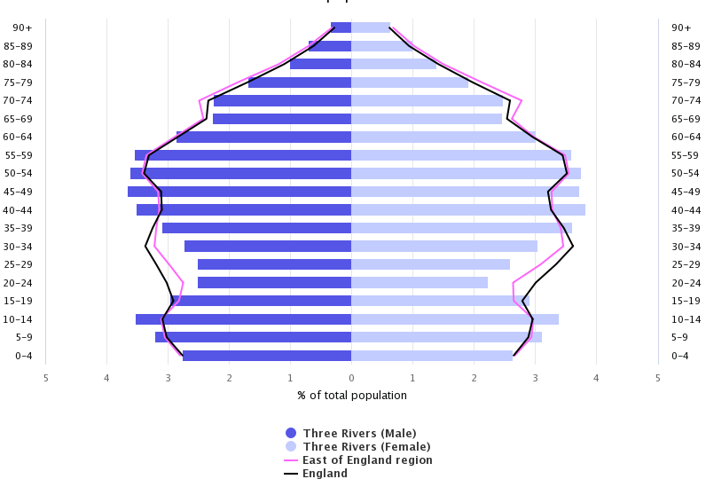
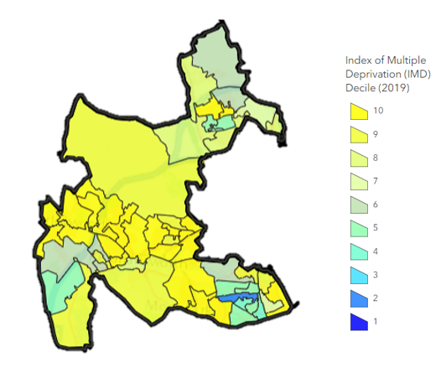
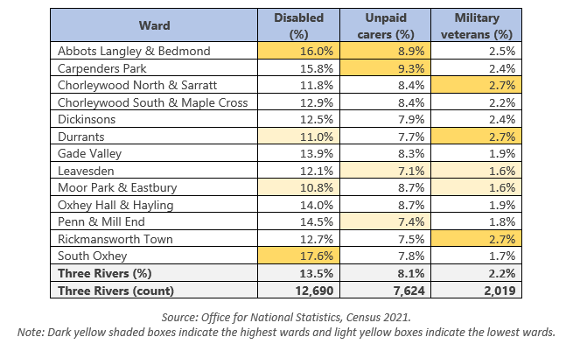
Population and demographic data
In some cases, we may use demographic data to contextualise information in terms of the local population
Recent example from Three Rivers Health Inequalities JSNA:
Age/sex population pyramid
Deprivation map
Characteristic groups by ward
www.hertshealthevidence.org
Notes:
In some cases, we include population and demographic data within JSNA products.
Whilst we don’t include this data as standard for JSNA documents, there are some topics in which it is beneficial to include an overview of our local population characteristics in order to contextualise the data and information covered in the JSNA. A good example of this is a Health Inequalities JSNA we have recently been working on for the Three Rivers district, from which the examples on this slide have been taken. In this JSNA, we included a local population profile for Three Rivers at the start of the document to highlight some key areas of inequality across the district.
We used the age and sex population pyramid as a quick and easy tool to compare the age and sex of Three Rivers residents to the regional and national averages, indicated by the pink and black lines. For example, at first glance we can see that Three Rivers has a much lower proportion of residents aged 20-39 than regional and national averages, but a higher proportion of residents aged 40-59.
We also included a deprivation map which highlighted geographical areas within the district which had a higher deprivation score, showing higher levels of inequality in these areas.
Lastly, we included a table showing the proportion of residents in each ward had characteristics such a registered disability, or were carers and military veterans. We then highlighted the highest and lowest wards within the table to easily identify which areas had the highest levels of need, in order to target areas for intervention.

Slide 7
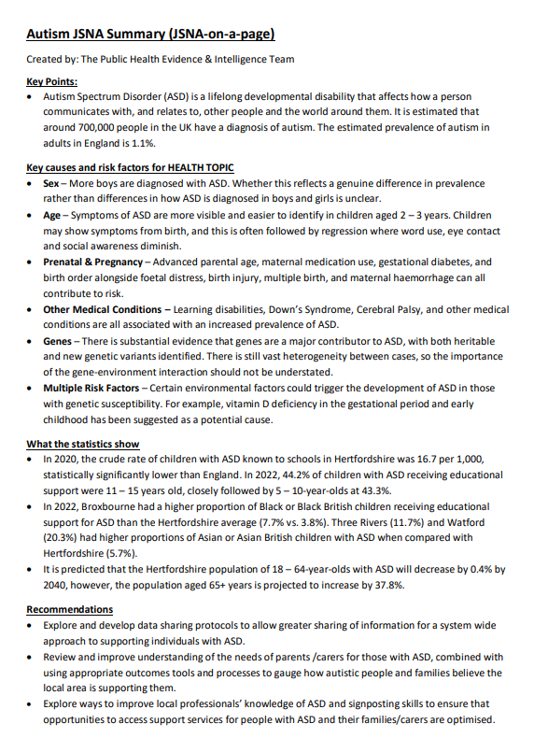
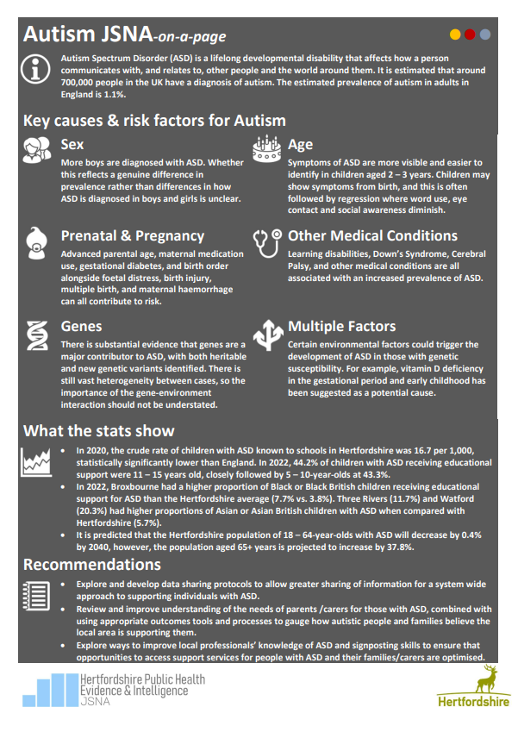
JSNA-on-a-page infographic
All JSNA briefings and full documents include a standard JSNA-on-a-page infographic
Provides one page summary for audiences requiring headline data and information
Summarises the key information including key risk factors, statistics and recommendations
Accessible version for screen readers
www.hertshealthevidence.org
Notes:
We produce one-page summary infographics, known as a JSNA-on-page, as standard for all of our JSNA Briefings and full documents. These infographics condense the data and information covered within the full JSNA or Briefing documents to provide a simple, visual summary of the information within the JSNA. These are useful resource for audiences wishing to see the headlines from the JSNA without reading the full document, for example Councillors or staff just wanting a summary of the key findings from the JSNA.
The infographics start with a couple of bullet points outlining the JSNA topic, followed by a summary of the key causes and risk factors for the issue, as identified through academic literature and research. The infographics then move on to provide the headline data and statistics which illustrate the scale of the issue. Finally, they pick out some of the key evidence-based recommendations from the document.
To ensure that these infographics are accessible, we also produce an accessible version for screen readers, both of which get uploaded to our JSNA website.

Slide 8
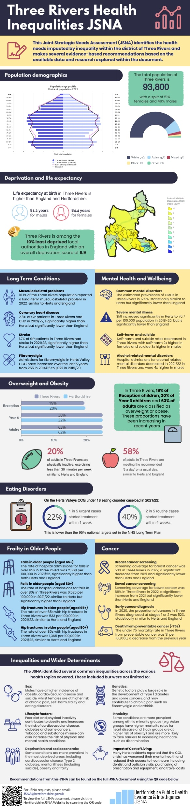
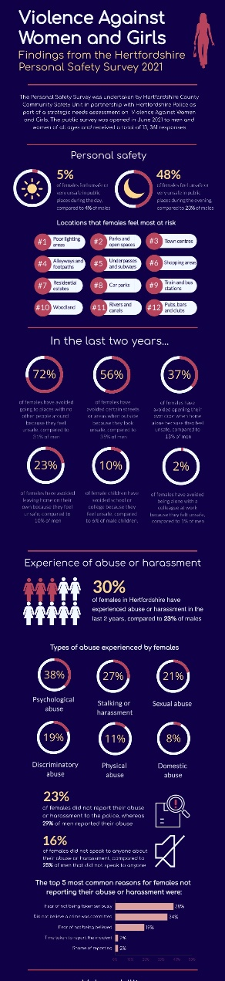
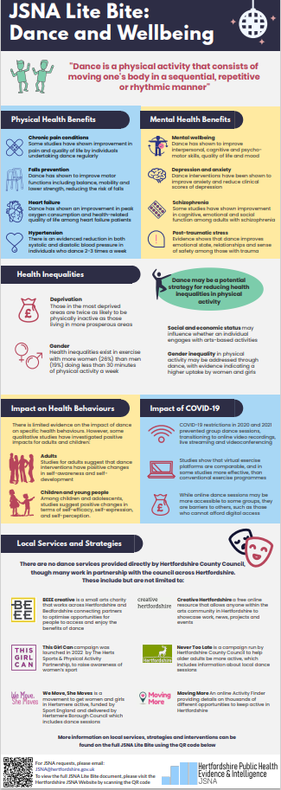
Bespoke infographics (£)
Provide an engaging, visual summary of the key findings and data from the JSNA product
Separate data and information into key themes to ‘tell a story’
Use icons, graphics and data widgets to present and emphasise information
Recent examples:
Dance and Wellbeing JSNA Lite Bite
Three Rivers Health Inequalities JSNA
Violence Against Women and Girls survey findings
www.hertshealthevidence.org
Notes:
In addition to our standard JSNA-on-page summaries, we have recently start to accept requests for producing bespoke infographics to accompany JSNA products. These infographics are intended to provide an engaging, visual summary of the key findings and data from the related JSNA product, telling a story of the JSNA topic as it flows. Please note that bespoke infographics are a chargeable service due to the additional time and resource required to produce them, so please email the JSNA team if you would like to enquire about costings for bespoke infographics.
We adapt the format of bespoke infographics to the topic to separate the most key data and information. We start by splitting the key information into themes, and working out what will be the most effective and logical way to display the information. We have access to a gallery of icons, graphics and data widgets which enable us to present and emphasise information in a variety of engaging ways, whilst ensuring that the format is consistent throughout. We can also include a variety of graphs and charts in our infographics, though we try to keep them as clear and simple as possible. We finish off each infographic at the bottom with a QR code linking to the JSNA document.
Infographics for smaller documents such as JSNA Lite Bites tend to be around 1-2 pages, whereas we try to keep infographics for full documents no more than 2-3 pages depending on the complexity of the JSNA to ensure that they remain summary level documents.
Some examples of recent bespoke infographics we have produced are shown on the right hand side. The first of these examples is an infographic we produced for our Dance and Wellbeing JSNA Lite Bite, which is split into themes such as physical and mental health benefits of dance, health inequalities and the impact of the COVID-19 pandemic. As this was based from a Lite Bite, this example is focused on academic literature findings and includes a small section on local services.
The second example is an infographic we have produced for a health inequalities JSNA for the Three Rivers district. As this was a full needs assessment document, this example has more focus on the key data and statistics. We have started the infographic by giving an overview of the local population data, and then outlining the key data under 5 different health themes to ensure that the infographic is easy to understand and navigate. It also includes a small section picking up on key inequalities and risk factors for these conditions.
The last example is an infographic that was produced in collaboration with the County Community Safety Unit which summarises the key findings from a public survey undertaken as part of our Violence Against Women and Girls needs assessment. This infographic also has a focus on the data and statistics, with emphasis on the most key statistics to make this information stand out more.

Slide 9
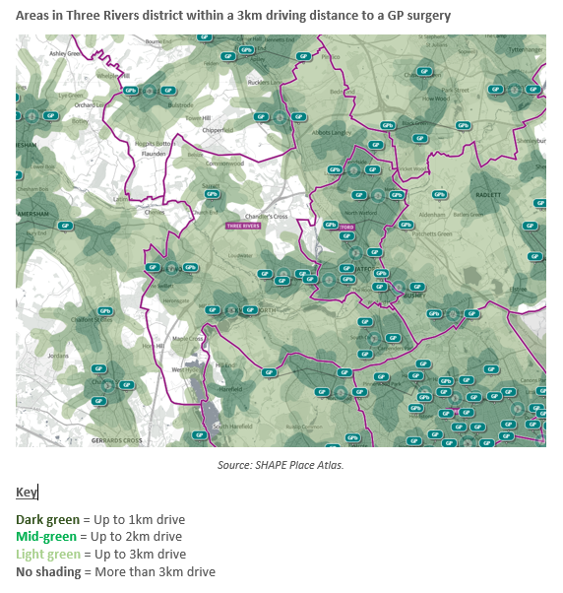
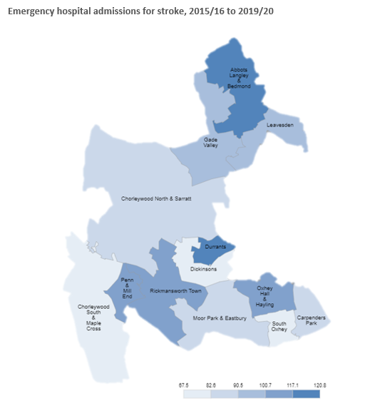
Geographical maps
Maps can be a useful visual tool for identifying health inequalities across a geographical area
Can also be used to identify areas with reduced healthcare access
Please note maps may be chargeable (£)
www.hertshealthevidence.org
Notes:
In some cases and where appropriate, we may be able to include geographical maps. Maps can be a useful visual tool for identifying health inequalities across a geographical area, or identifying areas of reduced access to health services.
The examples on this slide have also been taken from our Three Rives Health Inequalities JSNA. The bottom left map is showing the rate of emergency hospital admissions for stroke for each ward in Three Rivers, showing at a glance the wards with the highest rate of admissions and therefore areas where interventions may want to be targeted.
In contrast, the top right map is highlighting areas in the district within a 3km driving distance to a GP surgery. The areas with no colour are more than 3km drive from a GP surgery, helping to identify that there may be reduced healthcare access in these areas.
Please note maps may be chargeable depending on the time and resource required, as they are not included as part of the standard JSNA process.

Slide 10


JSNA
Find out more
For JSNAs, briefings or Lite Bites on a health topic submit a request to the JSNA team, through
www.hertfordshire.gov.uk/jsna
JSNA@hertfordshire.gov.uk
Find out more
www.hertshealthevidence.org
Notes:
Thank you for listening to this presentation.
If you have any questions, please feel free to drop us an email at JSNA@hertfordshire.gov.uk
You can also visit our website using the link on the screen to view our JSNA documents or submit a request for a JSNA product

