Slide 1

Public Health Evidence & Intelligence:
Introduction to the JSNA process
May 2023
www.hertshealthevidence.org

Slide 2
What we are talking about today
Quick intro to the JSNA
JSNA process & products
Joint working with community safety
Positive outcomes
www.hertshealthevidence.org

Slide 3



What is the JSNA?
Hertfordshire's Joint Strategic Needs Assessment (JSNA) looks at the specific health and social care needs of our local population and highlights areas of inequality. It helps public bodies decide what type of local services to commission.
The JSNA comprises a variety of needs assessments, each looking at a different issue. They are regularly updated to reflect the changing needs of the local population.
www.hertshealthevidence.org
Notes:
The Joint Strategic Needs Assessment (JSNA) is a statutory obligation that aims to improve the health and wellbeing of the local community by identifying the specific health and social care needs of the local population and highlighting areas of inequality. This could be health inequalities that exist between different groups, for example ethnic groups or age groups, or it could be health inequlaities in different locations. The JSNA is then used by public bodies to help inform commissioning decisions.
There is no standard format nationally for what a JSNA looks like, but here in Hertfordshire we produce a number of different JSNA reports with each one looking at a separate issue. JSNAs are then regularly updated using a prioritisation process and this allows us to ensure that we are identifying the changing needs of the population.

Slide 4
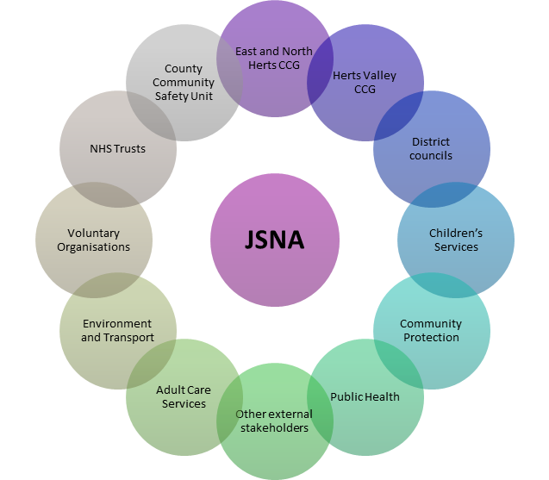
Responsibility for the JSNA
The JSNA is the responsibility of Hertfordshire’s Health & Wellbeing Board
The Health & Wellbeing Board brings together the NHS, public health, adult social care, children’s services, elected representatives and Hertfordshire Healthwatch to plan how best to meet the needs of Hertfordshire’s population and tackle local inequalities in health
Public Health Evidence and Intelligence team undertake the JSNA process on their behalf
www.hertshealthevidence.org

Slide 5
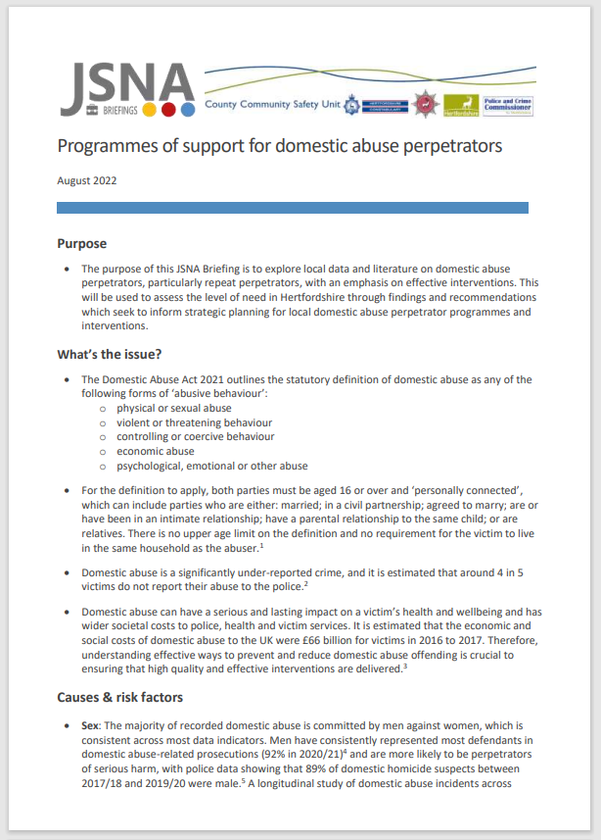
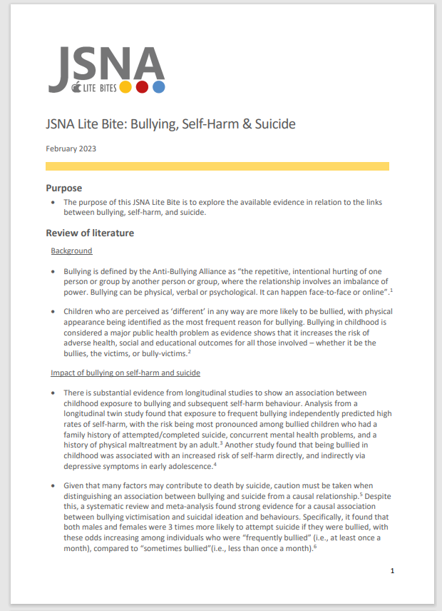
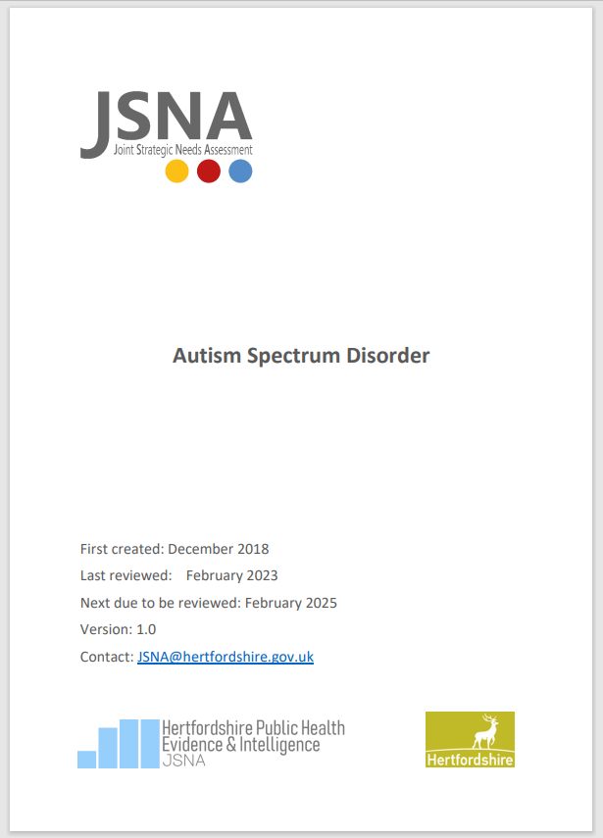

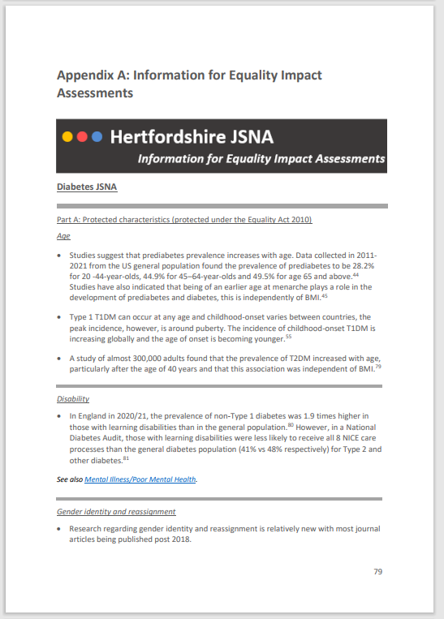
What do we do – JSNA products
JSNA products:
JSNAs
JSNA-on-a-page
and accessible version
Information for EqIAs
Case Studies
JSNA Briefings
JSNA Lite Bites
Infographics
Bespoke requests (£)
www.hertshealthevidence.org

Slide 6
What is included in a full JSNA report?
A JSNA report outlines specific problems that can arise from a particular health topic.
Identifies the causes and risk factors and then propose solutions through analysis of quantitative and qualitative data available
Purpose and background
Causes and risk factors
What do the statistics show
Local services, strategies and effective interventions
Limitations
Recommendations
Find out more
Appendices
References
Sets out recommendations that give the ‘so what?’ for commissioning and decision making
Purpose is to facilitate evidence-based commissioning – ensuring services meet the population’s needs in a way that makes the optimum use of available resources
www.hertshealthevidence.org
Notes:
A JSNA report outlines specific problems that can arise from a particular health topic. In Hertfordshire, for the JSNA we include set sections that are shown on the right hand side of the screen. We set out the purpose of each JSNA and provide background information on the topic. We then use literature searching to identify the causes and risk factors for a specific health issue and look at the statistics available on the topic. We then look at local services and local and national strategies as well as effective interventions to improve health outcomes. After this, we assess the limitations of our analysis and then provide recommendations that assist with commissioning decisions. The purpose of the JSNA is to facilitate evidence-based commissioning to make sure we meet the needs of the population in a way that makes optimum use of available resources.

Slide 7
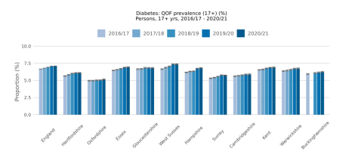
Evidence-based decision making
  Identifying problems using data
  looking at trends
  looking at statistical significance
Understanding causes and risk factors
from research and evidence
Understand what can be done to tackle the problem based on research and evaluation
  thinking about the quality of evidence every step of the way
www.hertshealthevidence.org
Notes:
As part of this evidence based decision making we will look at trends over time in Hertfordshire as well as compare Hertfordshire to other similar locations to see how Hertfordshire compares. We will look to see if these differences or trends are statistically significant. We also use literature searching and critical appraisal to select research articles that inform us about the causes and risk factors of the health issue. We use literature searching and critical appraisal again to identify effective interventions to address health issues to help make sure our recommendations are evidence based.

Slide 8


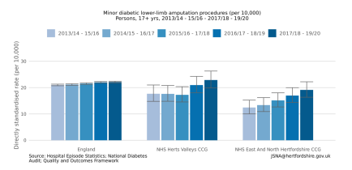
What’s involved in the JSNA process
  Organising working groups
  Liaising with stakeholders and chasing data and intelligence
  Literature searching
  Data analysis
  Creating content
  Referencing
  Proofreading
  Uploading to website and dissemination
  Delivering presentations
  Providing support for implementing recommendations from JSNAs
www.hertshealthevidence.org
Notes:
When creating a new JSNA we create a working group with different stakeholders that are invested in the health topic. Therefore, we have to organise these working groups and take minutes as well as aim to ensure that a diverse range of stakeholders are included within the process. This will also involve liasing with stakeholders over email, Teams and sharepoint and ensuring actions from the working group are completed. Other elements of the JSNA include literature searching on databases and correctly referencing, analysing data and generating graphs, creating clear content and proofreading drafts. After the JSNA is completed, we upload this to the JSNA website and then send a copy to the stakeholders as well as inform relevant newsletters about the publication. We also deliver presentations at request to summarise the findings from the JSNA and can provide support for implementing the recommendations from the JSNA.

Slide 9
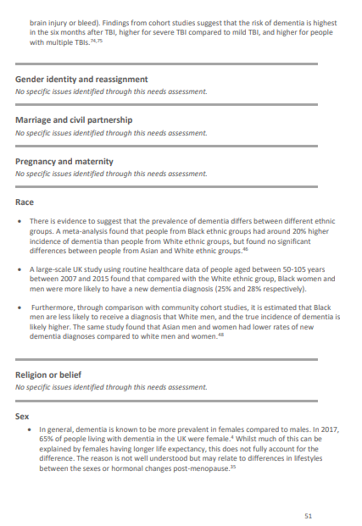
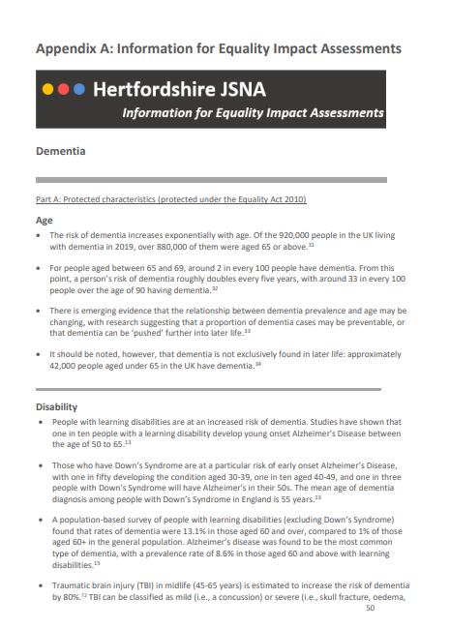
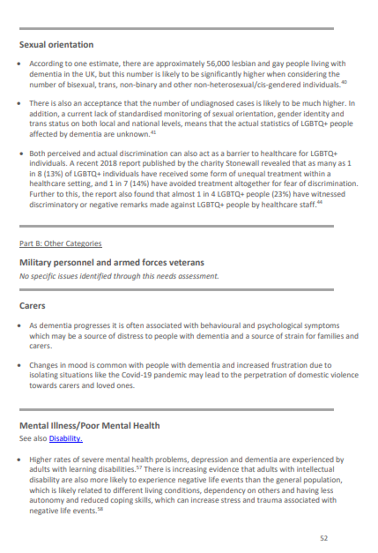
Information for EqIAs
Information for an Equality Impact Assessment (EqIA) can be found in the appendix of each JSNA report.
This section extracts relevant data from throughout the JSNA report to provide evidence relating to each protected characteristic as per the Equality Act 2010.
The information for EqIA section also includes data on: Military Personnel & Armed Forces Veterans, Carers, Mental Illness, Children Looked After & Care Leavers, and the Impact of COVID-19.
www.hertshealthevidence.org
Notes:
In each JSNA, there is a section called Information for Equality Impact Assessment that is found in the appendix. This section is split into the characteristics that are protected under the equality act such as age, disability and sexual orientation and pulls out the relevant data that has been included in the JSNA on that subtopic. We also include sections on additional groups including military personnel and armed forces veterans, carers, and children looked after and care leavers, and also include information about mental illness and mental health and the impact of COVID-19.

Slide 10
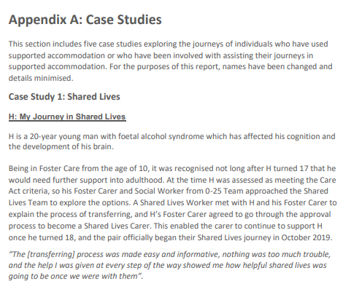
Case studies – lived experience
Where possible, case studies are included within the appendices of the JSNA.
This can include service users, carers and/or commissioners.
A recent example is the Adult Supported Living and Accommodation-Based Care JSNA that included 5 case studies.
www.hertshealthevidence.org
Notes:
Another section in the appendix are case studies. We try to include case studies of lived experiences in JSNAs where possible. Case studies may be from service users or carers or are alternatively written by commissioners to provide insight on topics where it may have been difficult to get data on. A recent example of a JSNA with case studies is the Adult Supported Living and Accommodation-Based Care JSNA. This included 5 case studies – 3 were based on service users, 1 was from a carer of someone living in supported accommodation and another was commissioner’s insight on supported accommodation issues for working aged adults with disabilities and working aged autistic people. This helped to provide important information that was used to inform recommendations.

Slide 11
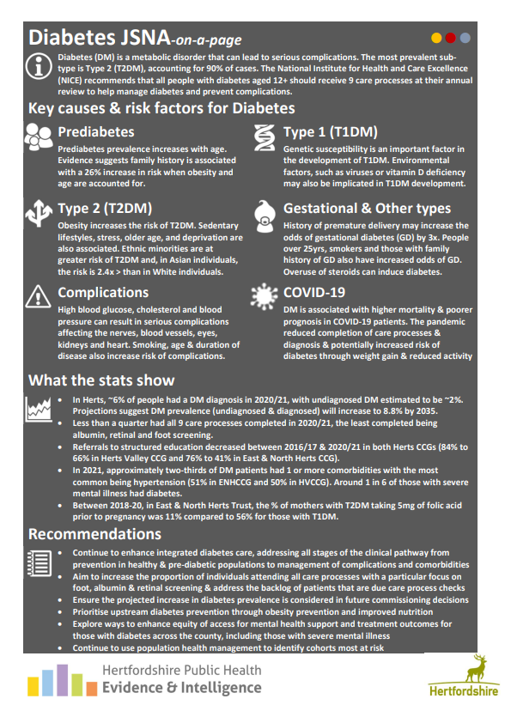
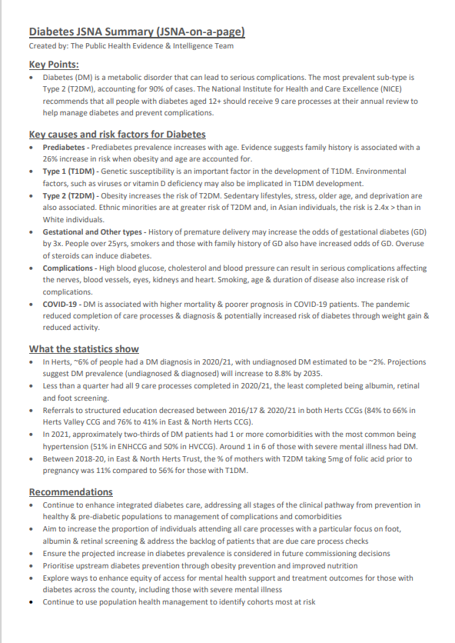
JSNA on a page executive summary
A JSNA-on-a-page is an infographic one page summary of a JSNA or a JSNA briefing.
An accessible version for those who have screen readers is also produced for each topic.
www.hertshealthevidence.org

Slide 12
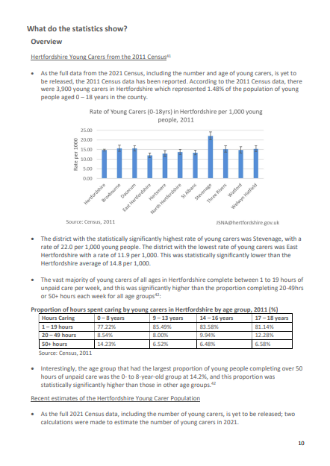
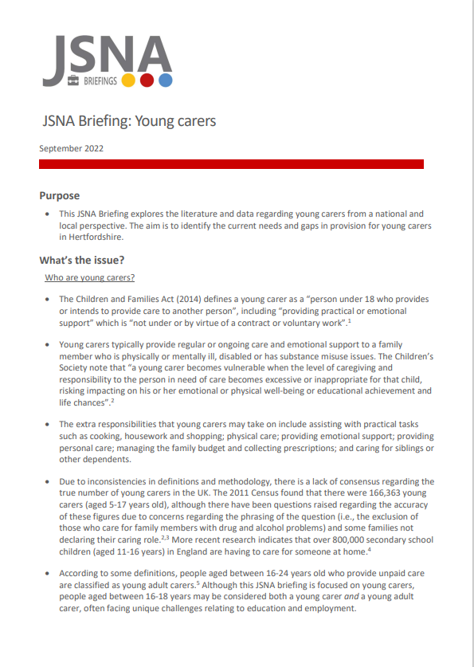
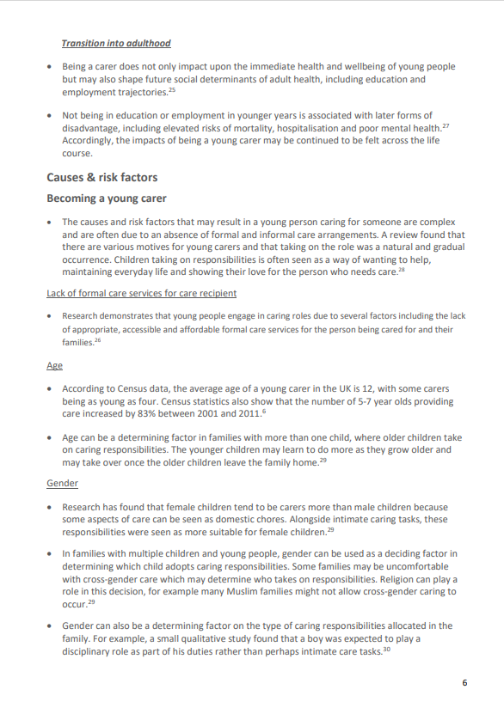
JSNA Briefings
Shorter reports which cover the same subsections of the JSNA but in a more condensed form.
Do not always have appendices, for example they may exclude the ‘info for equality impact assessments’ section.
Not required to follow the same format as the JSNA working groups.
May involve the help of a much smaller working group or a few colleagues.
-> COVID-19 Pandemic
-> Domestic Abuse: Programmes of Support for Perpetrators
-> Gambling-related Harms
-> Physical Activity
-> Young Carers
www.hertshealthevidence.org
Notes:
Another product that the JSNA team produces are JSNA briefings, these are shorter reports that cover the same subsections of the JSNA but in a more condensed form and so can be produced in a much faster timeframe. Full JSNA reports can be upwards of 50-60 pages, whereas JSNA briefings are generally 10-15 pages in length. JSNA briefings do not always have appendices, for example they may exclude the information for equality impact assessments section. They aren’t produced using the same format as JSNAs and so do not involve the full JSNA working groups as these can take 3-6 months to produce. They may involve the help of a much smaller working group or a few colleagues that provide resources and input for the JSNA. Examples of JSNA briefings include briefings on the covid-19 pandemic, programmes of support for perpetrators of domestic abuse, gambling related harms, physical activity and young carers. A current example of a jsna briefing we’re working on is maternal health.

Slide 13
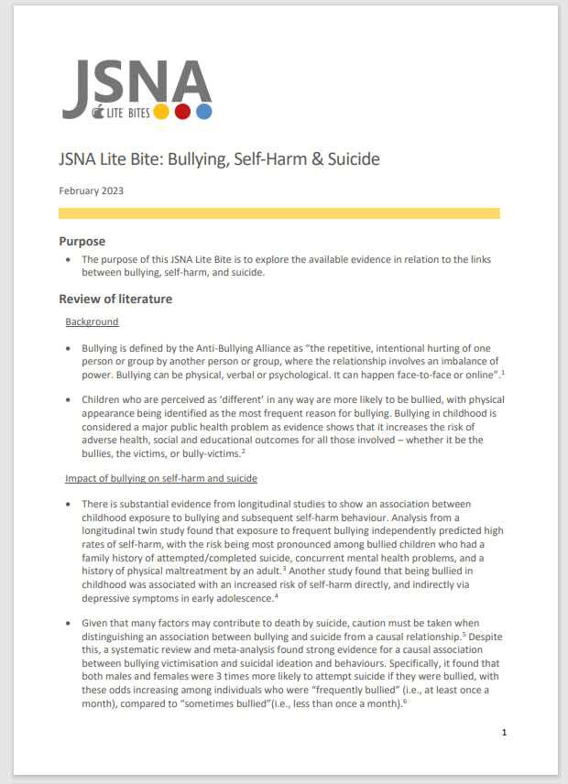
JSNA Lite Bites
  A rapid literature review into a specific health topic
  Can be 2-6 pages long
  Includes summary level evidence & links off to more information
  Can summarise health interventions that exist on the topic
  Doesn’t have a specific data section but can summarise
  Doesn’t include recommendations
  Can be created & published in around 2 weeks-time
-> Impact of age and driving inexperience on road traffic collisions
-> Impact of preconception smoking on neonatal outcomes
-> Risk of suicide in children and young people with ADHD and ASD
-> Impact of arts and culture on national and local wellbeing
-> Health Risks of Damp and Mould
www.hertshealthevidence.org
Notes:
JSNA Lite Bites are a fairly new product that we have introduced but been found to be a really useful resource for stakeholders and can be produced quite quickly. JSNA Lite Bites provide a rapid literature search into a specific focused research question. They can be around 2-6 pages in length and provide summary level evidence for a topic with links to further information. They may for example summarise health interventions that exist on a topic or look at barriers for a health topic. Lite Bites don’t have a specific data section within them though we can provide a brief summary of local data if needed. One of the differences between Lite Bites and briefings and full reports is that lite bites don’t include recommendations and include a summary of information instead. They can be created and published in around a 2-week timeframe. Some examples of litebites that we have done include looking at the Impact of age and driving inexperience on road traffic collisions
-> Impact of preconception smoking on neonatal outcomes
-> Risk of suicide in children and young people with ADHD and ASD
-> Impact of arts and culture on national and local wellbeing
-> Health Risks of Damp and Mould

Slide 14
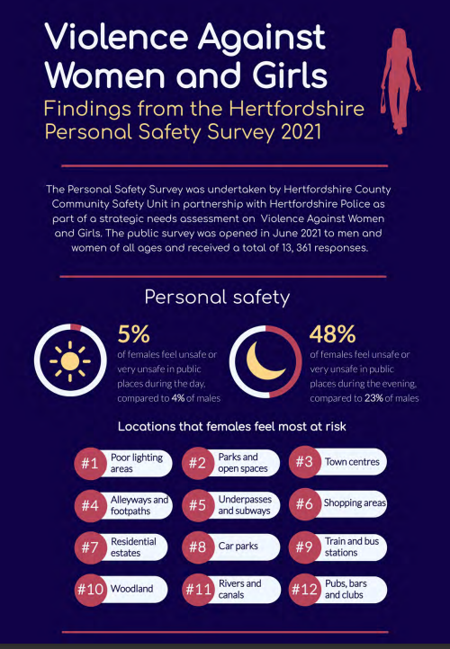
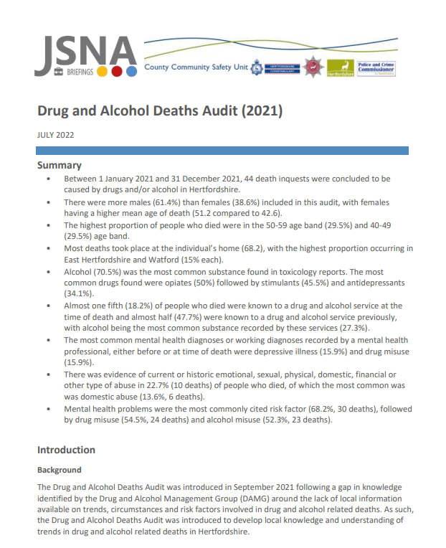


Joint working with Community Safety
  Collaborate with County Community Safety Unit (CCSU)
  2 co-located analysts
  Promotes joint working on topics which overlap health and community safety
  Recent examples include:
  Modern slavery (currently updating)
  Violence Against Women and Girls
  Asylum Seekers and Refugees
  Demand of Mental Health on Local Services
  Serious Violence
  Domestic Abuse
  Drug and Alcohol products
www.hertshealthevidence.org
Notes:
The JSNA team have close ties to the county community safety unit and we also have 2 co-located analysts. This helps to promote joint working on topics which overlap health and community safety. Some examples of collaborative JSNA topics that have been produced include
Violence Against Women and Girls
Asylum Seekers and Refugees
Demand of Mental Health on Local Services
Serious Violence
Domestic Abuse
Drug and Alcohol products
The modern slavery JSNA is also being currently updated

Slide 15
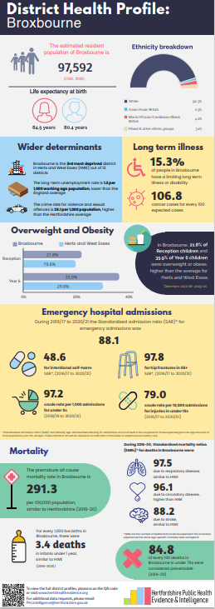

Infographics
A more comprehensive executive summary
Can be created as a standalone product or in conjunction with a JSNA
Typically a paid-for product
Some examples include:
-> District Health Profiles
-> Dance and Wellbeing
-> Three Rivers Health Inequalities
www.hertshealthevidence.org
Notes:
One of the paid for products that we also produce are infographics. These provide a more comprehensive executive summary than provided by the JSNA on a page and also are designed with the audience in mind to capture attention. The two examples on the right are for infographics that we have produced. One is for the district health profile for broxbourne and the other is for the dance and wellbeing JSNA Lite Bite that was produced

Slide 16
Positive outcomes
  Hertfordshire Healthy Mouths Pilot used a JSNA Lite Bite to help look at and plan an effective intervention targeting oral health/oral hygiene of children aged 0-5 years.
  The Child Death Panel (CDP) uses JSNA Lite Bites to understand the causes & risk factors of certain childhood health conditions.
  SEND JSNA was used to provide the evidence for the 2023 Ofsted inspection of the Local Area Partnership SEND services and also to inform strategic planning and local service provision.
  Drug and Alcohol Deaths Audit was used to target areas for rollout of naloxone to frontline staff in Herts to areas of greatest identified need and has been successfully administered to prevent some drug deaths.
  VAWG Personal Safety Survey 2022 findings provided the evidence base for government bid for local funding to help women and girls feel safer in Herts.
www.hertshealthevidence.org
Notes:
Looking at the impact of age and driving inexperience on road traffic accidents and lite bites looking at suicides

Slide 17


Find out more
The JSNA team’s PH Knowledge and Skills session in March 2023 on ‘Critical appraisal and hierarchy of evidence’ will be available on the PH staff pages
For JSNAs, briefings or Lite Bites on a health topic submit a request to the JSNA team, through
www.hertfordshire.gov.uk/jsna
JSNA@hertfordshire.gov.uk
Future JSNA topics include: Adults Experiencing Multiple Disadvantages, Carers, Oral Health and Menopause.
Find out more
www.hertshealthevidence.org
Notes:
Any questions?
Handover to Jo Mackenzie

