Slide 1
Herts public health connect master class series – today’s master class will start shortly An overview of the challenges and barriers faced by the Gypsy Roma Traveller (GRT) communities in Hertfordshire and the UK
Chair: Claire Laurent, Consultant in Public Health, Hertfordshire County Council
Tweet today using #hertsphconnect

Slide 2
Today’s speakers:
Welcome from Claire Laurent, Consultant in Public Health, Hertfordshire County Council
Sukhi Khattran, Health Improvement Co-ordinator, Mental Health and Suicide Prevention, Hertfordshire Public Health
Josephine (Josie) O’Driscoll, CEO, GATE Herts
Dr David Smith, Reader in Social Policy, Anglia Ruskin University
Dr Martin Logue, Senior Research and Evaluation Officer, Evidence and Intelligence, Public Health, Hertfordshire County Council
Ruth Reilly, Postgraduate Researcher, University of Hertfordshire
#hertsphconnect

Slide 3
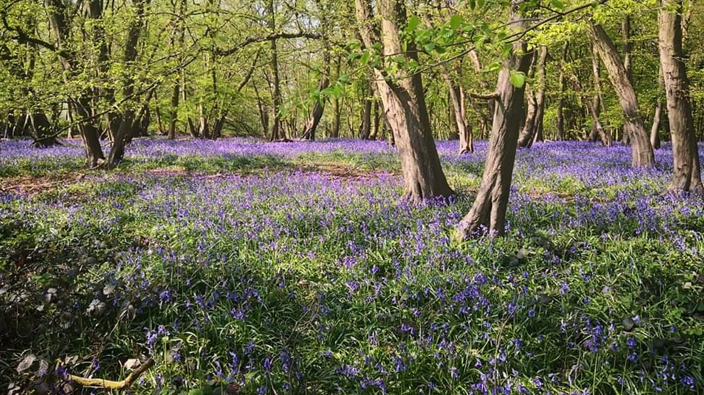
Supporting Mental Health and Suicide Prevention in Gypsy, Roma and Traveller Communities in Hertfordshire
Sukhi Khattran​​ - Health Improvement Co-Ordinator, Public Health (Working with Gypsy, Roma and Traveller Communities)
Creating a cleaner, greener, healthier Hertfordshire

Slide 4
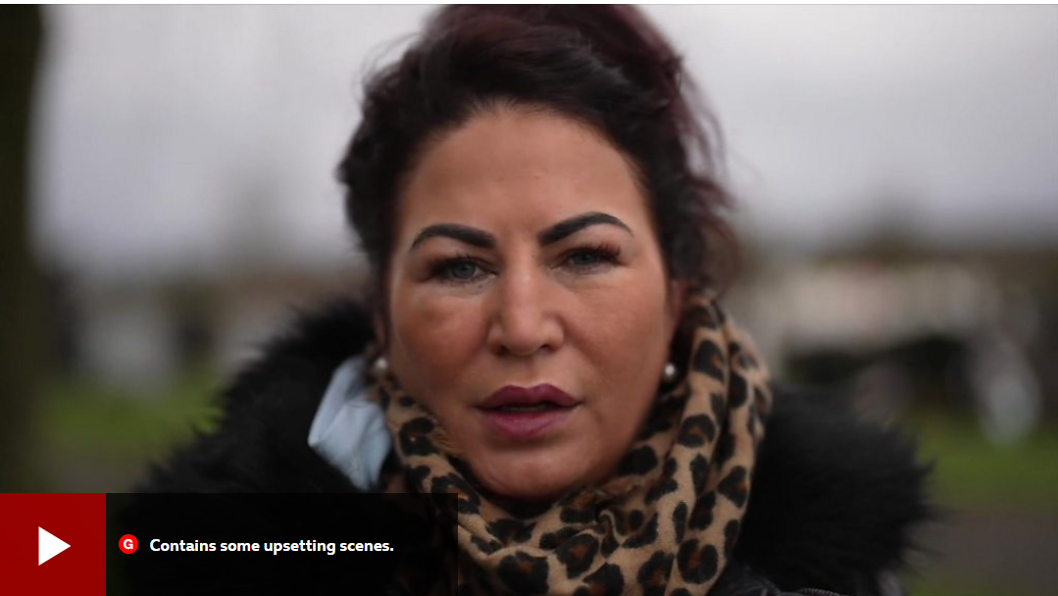
Stigma & discrimination
Why it matters
Huge impact on mental well-being
Higher rates of suicide
Culturally appropriate services often non-existent
Discrimination and stereotyping despite generational socio and economic inequalities
https://www.bbc.com/news/world-europe-61117469
Creating a cleaner, greener, healthier Hertfordshire

Slide 5
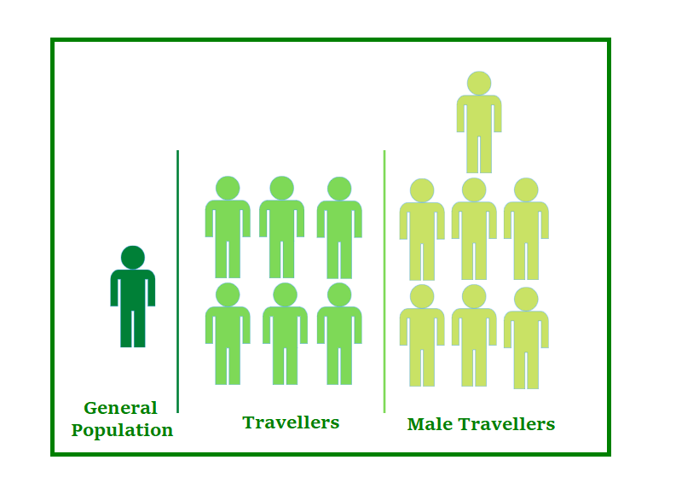
Access to Services
Building Blocks
Literacy
HIGH SUICIDE RATES
Information often not understood or accessible
Affects access to services
Creating a cleaner, greener, healthier Hertfordshire

Slide 6
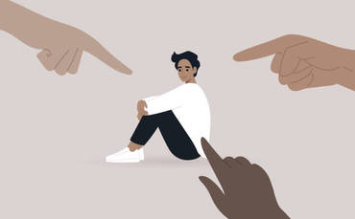
Access to services
Building Blocks
LACK OF CULTURAL COMPETENCY
Cultural Features
Distinct Groups
Specific Needs
Language
Shame
Stereotyping
Prejudice and bias
STIGMA
Dialogue
Men’s suicide rates
Lack of initiatives
Generational
Creating a cleaner, greener, healthier Hertfordshire

Slide 7
Creating change and making a difference
Create an understanding
Rebuild
Communities needs
Challenges
Barriers & inequalities
Trust and confidence in services
Remove Stigma
Whole population approach
Shared knowledge
Equal access and equal outcomes
Challenges
Collaborate & co-produce
Creating a cleaner, greener, healthier Hertfordshire

Slide 8
Creating change and making a difference
Communication and Support
Steering Group
Facilitate Conversations and Conduit for change
Bereavement Support
Raise Awareness
Health
Improvement
Co-ordinator
HCC Corporate Values
GATE Herts & Funded Activities
Co-Production
World Suicide Prevention Day
Creating a cleaner, greener, healthier Hertfordshire
Empower partners

Slide 9
Steering Group Members
Creating a cleaner, greener, healthier Hertfordshire

Slide 11
Gypsy and Travellers in Hertfordshire

Slide 12
Defining Gypsy and Travellers
The Term Gypsy, Roma, Traveller (GRT) is not used to describe a single ethnic group but is an umbrella or collective term for a broad and diverse range of distinct ethnic minorities with shared cultural norms, traditions, and values.
The most commonly known nominator is their shared history of nomadism.
While this history remains culturally relevant and essential to many people, it is important to note that in the UK, an estimated 75% of GRT people live in bricks and mortar accommodation and approximately 20% on permanent caravan sites. Roughly 2% - 5% of ethnic GRT people live nomadically today.
To our best knowledge, some Roma people live nomadically in the UK.

Slide 13
Who are the groups under the GRT acronym?
Gypsy, Traveller, Roma, Showmen, and Boater communities
Traveller is an umbrella term that includes different groups and communities
Gypsy
Roma
Traveller (Irish, Scottish, Welsh, New)
Showmen
Boaters (Bargee)

Slide 14
Notes:
https://www.travellerstimes.org.uk/heritage/roads-past-short-history-Britains-Gypsies-Roma-and-Travellers

Slide 15
Traveller groups which are known as ‘cultural’ rather than ‘ethnic’ Travellers. These include Showmen and ‘new’ Travellers
Showmen
Show People are a cultural minority that have owned and operated funfairs and circuses for many generations and their identity is connected to their family businesses. They operate rides and attractions that can be seen throughout the summer months at funfairs. They generally have winter quarters where the family settles to repair the machinery that they operate and prepare for the next travelling season.

Slide 16
“New Travellers”
The term New Travellers refers to people sometimes referred to as “New Age Travellers”. They are generally people who have taken to life ‘on the road’ in their own lifetime, though some New Traveller families claim to have been on the road for three consecutive generations. The New Traveller culture grew out of the hippie and free-festival movements of the 1960s and 1970s.

Slide 17
Housing
The living situation varies greatly.
Some GRT live in houses or flats (often referred to as bricks and mortar), some live in chalets on private land with only a small number of neighbours, and others on large sites owned and managed by the local authority.
Some Gypsy Travellers continue to live a mostly nomadic lifestyle, stopping at transit sites, or on the side of the road where they can; however, this is becoming increasingly difficult. There is a lack of authorised stopping places, apprehension about being moved on by police if they stop elsewhere, and fears of prosecution because of the recently introduced Police, Crime, Sentencing and Courts Act (2022).
Increasing provision of permanent and transit sites, designed through consultation with communities, is a way forward in addressing the current housing and accommodation challenges reported by Gypsies and Travellers

Slide 18
Families and households People aged under 18 made up over a third (36%) of the Gypsy or Irish Traveller population, higher than the national average of 21%. 18.0% of Gypsy or Irish Traveller people were aged 50 and above, lower than the national average of 35.0%.
Across all household types, 44.9% of Gypsy or Irish Traveller households had dependent children, compared with an average of 29.1%.
8.4% of Gypsy or Irish Traveller households were made up of pensioners (either couples, single pensioners, or other households where everyone was aged 65 and over), compared with 20.9% on average.

Slide 19
Education At all key stages, Gypsy, Roma and Irish Traveller pupils’ attainment was below the national average. In the 2018 to 2019 school year, 19% of Gypsy or Roma pupils, and 26% of Irish Traveller pupils met the expected standard in key stage 2 reading, writing and maths. These were the 2 lowest percentages out of all ethnic groups. Gypsy or Roma (58%) and Irish Traveller (59%) pupils were the least likely to stay in education after GCSEs (and equivalent qualifications). In the 2019 to 2020 school year, the suspension rates were 15.28% for Gypsy or Roma pupils, and 10.12% for Irish Traveller pupils – the highest rates out of all ethnic groups. Also, the highest permanent exclusion rates were among Gypsy or Roma pupils (0.23%, or 23 exclusions for every 10,000 pupils). Irish Traveller pupils were permanently excluded at a rate of 0.14%, or 14 exclusions for every 10,000 pupils.

Slide 20
Health
2011
In 2011, 14.1% of Gypsy and Irish Travellers people in England and Wales rated their health as bad or very bad, compared with 5.6% on average for all ethnic groups.
2016–2017
In 2016 to 2017, Gypsy or Irish Travellers people aged 65 and over had the lowest health-related quality of life of all ethnic groups (average score of 0.509 out of 1).
They were also among the groups that had the least success when booking an NHS dentist appointment – 89.0% reported successfully booking an appointment in 2018 to 2019.
The Gypsy or Irish Traveller group were also less satisfied with their access to GP services in 2018 to 2019 – 56.9% reported a positive experience of making a GP appointment, compared to an average of 67.4% for all respondents.

Slide 21
Gypsy, Roma and Traveller people may be reluctant to self-identify, even where the option is available to them. This is because Gypsy, Roma and Traveller people often mistrust the intent behind data collection.
Equality Act 2010
Romany Gypsies and Irish Travellers are recognised as two distinct ethnic minority groups in law because they are identified as members of communities with a shared history, culture and language stretching back over hundreds of years.
As such, they are granted the complete protection of the Equality Act.
A 2018 YouGov poll found that 66% of people in the UK wrongly viewed GRT as not to be an ethnic group, with many mistaking them as a single group.
Therefore, GRT communities must be categorised correctly on data forms, using separate tick boxes when possible, to reflect this.

Slide 22
We believe the Census is a massive undercount as researchers looking at other statistics, such as the bi-annual Traveller caravan count and school roll figures, suggest that there are probably more like 200,000 -300,000 Romany Gypsy and Traveller people living in England and Wales. Some campaigners suggest that there may be up to a million.
For the first time, the 2011 Census ethnic group question included a tick box for the ethnic group ‘Gypsy or Irish Traveller’. This was not intended for people who identify as Roma because they are a distinct group with different needs to Gypsy or Irish Travellers.
2021 Roma was included as an ethnic category for the first time in the Census, and the number of people who filled in the form and identified as Roma was 100,981.
67,768 people identified as ‘Gypsy or Irish Traveller’, which is a rise from the 58,000 people who identified as such in the 2011 Census – the first time this category was included.

Slide 23
CENSUS 2021
Essex has the largest Gypsy or Irish Traveller population, with 1.5% of all Gypsy or Irish Traveller people living there, followed by Maidstone (also 1.5%, although it had a smaller population).
28 local authorities had fewer than 20 Gypsy or Irish Traveller residents each.
This is around 1 in 12 of all local authorities.
81.6% of people from the Gypsy or Irish Traveller ethnic group were born in England,
6.1% in the other countries of the UK. 3.0% were born in Ireland
8.3% were born somewhere else in Europe (other than the UK and Ireland).
Less than 1.0% of Gypsy or Irish Traveller people were born outside of Europe.

Slide 24
Gypsy and Traveller sites in Hertfordshire
55 Gypsy and Traveller sites in Hertfordshire.
Sites managed by HCC
10 permanent sites, providing 187 pitches.
1 short stay (transit) site, providing 15 pitches. Pitch rent: £94.54

Slide 25
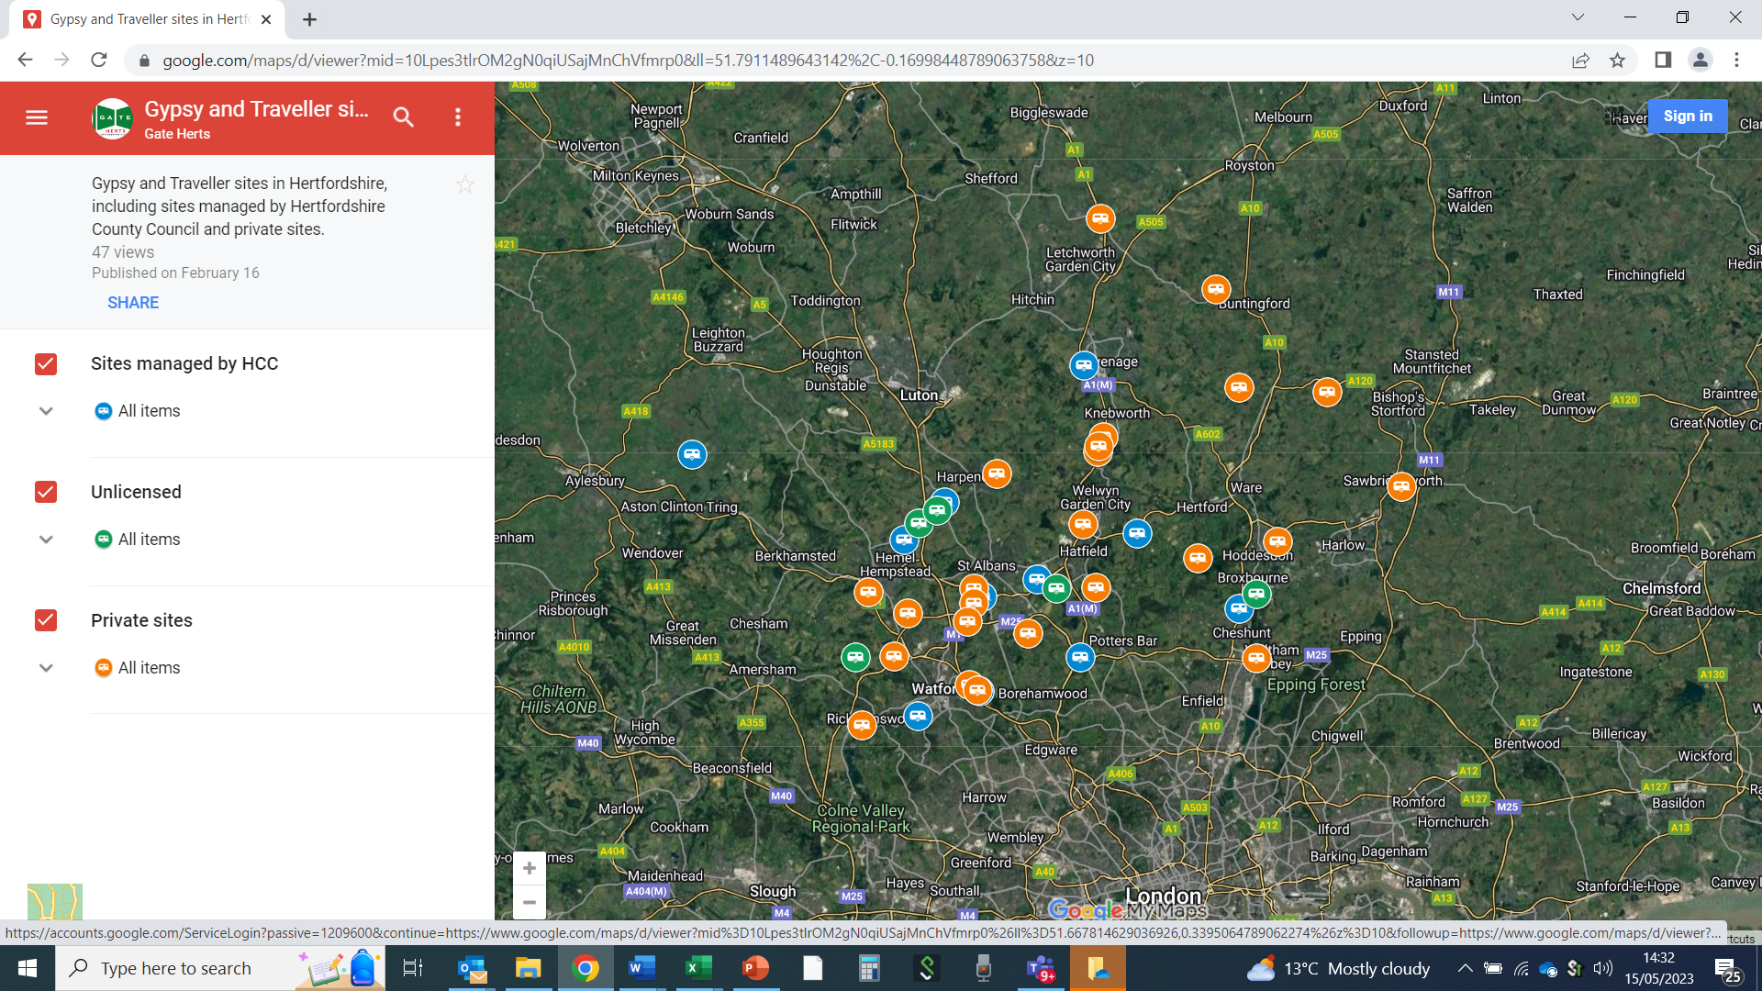

Slide 26
The 2021 Census had a ‘Gypsy/Irish Traveller’ category, and a new ‘Roma’ category. Breakdown of 2021 Census for Gypsy Roma Travellers in Hertfordshire 3325
Broxbourne 338
Dacorum 396
East Herts 429
Hertsmere 449
North Herts 120
St Albans 292
Stevenage 167
Three Rivers 176
Watford 425
Welwyn Hatfield 533

Slide 27
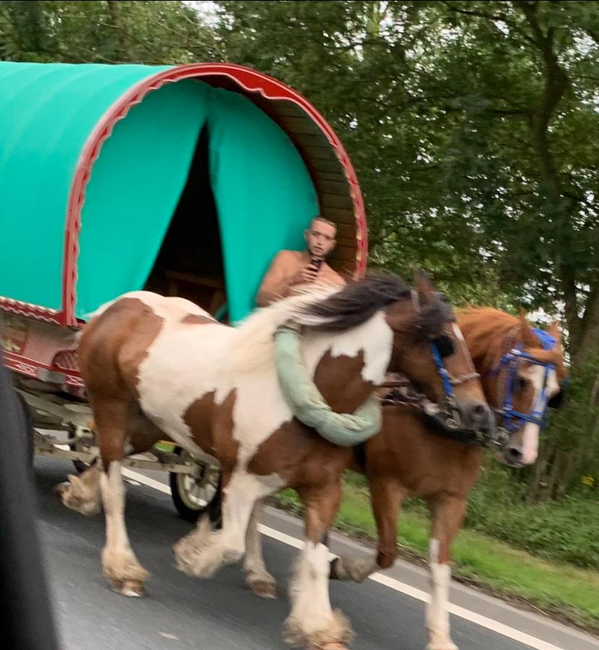
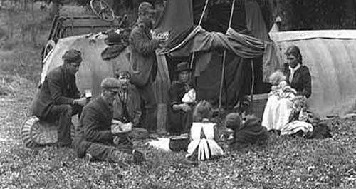
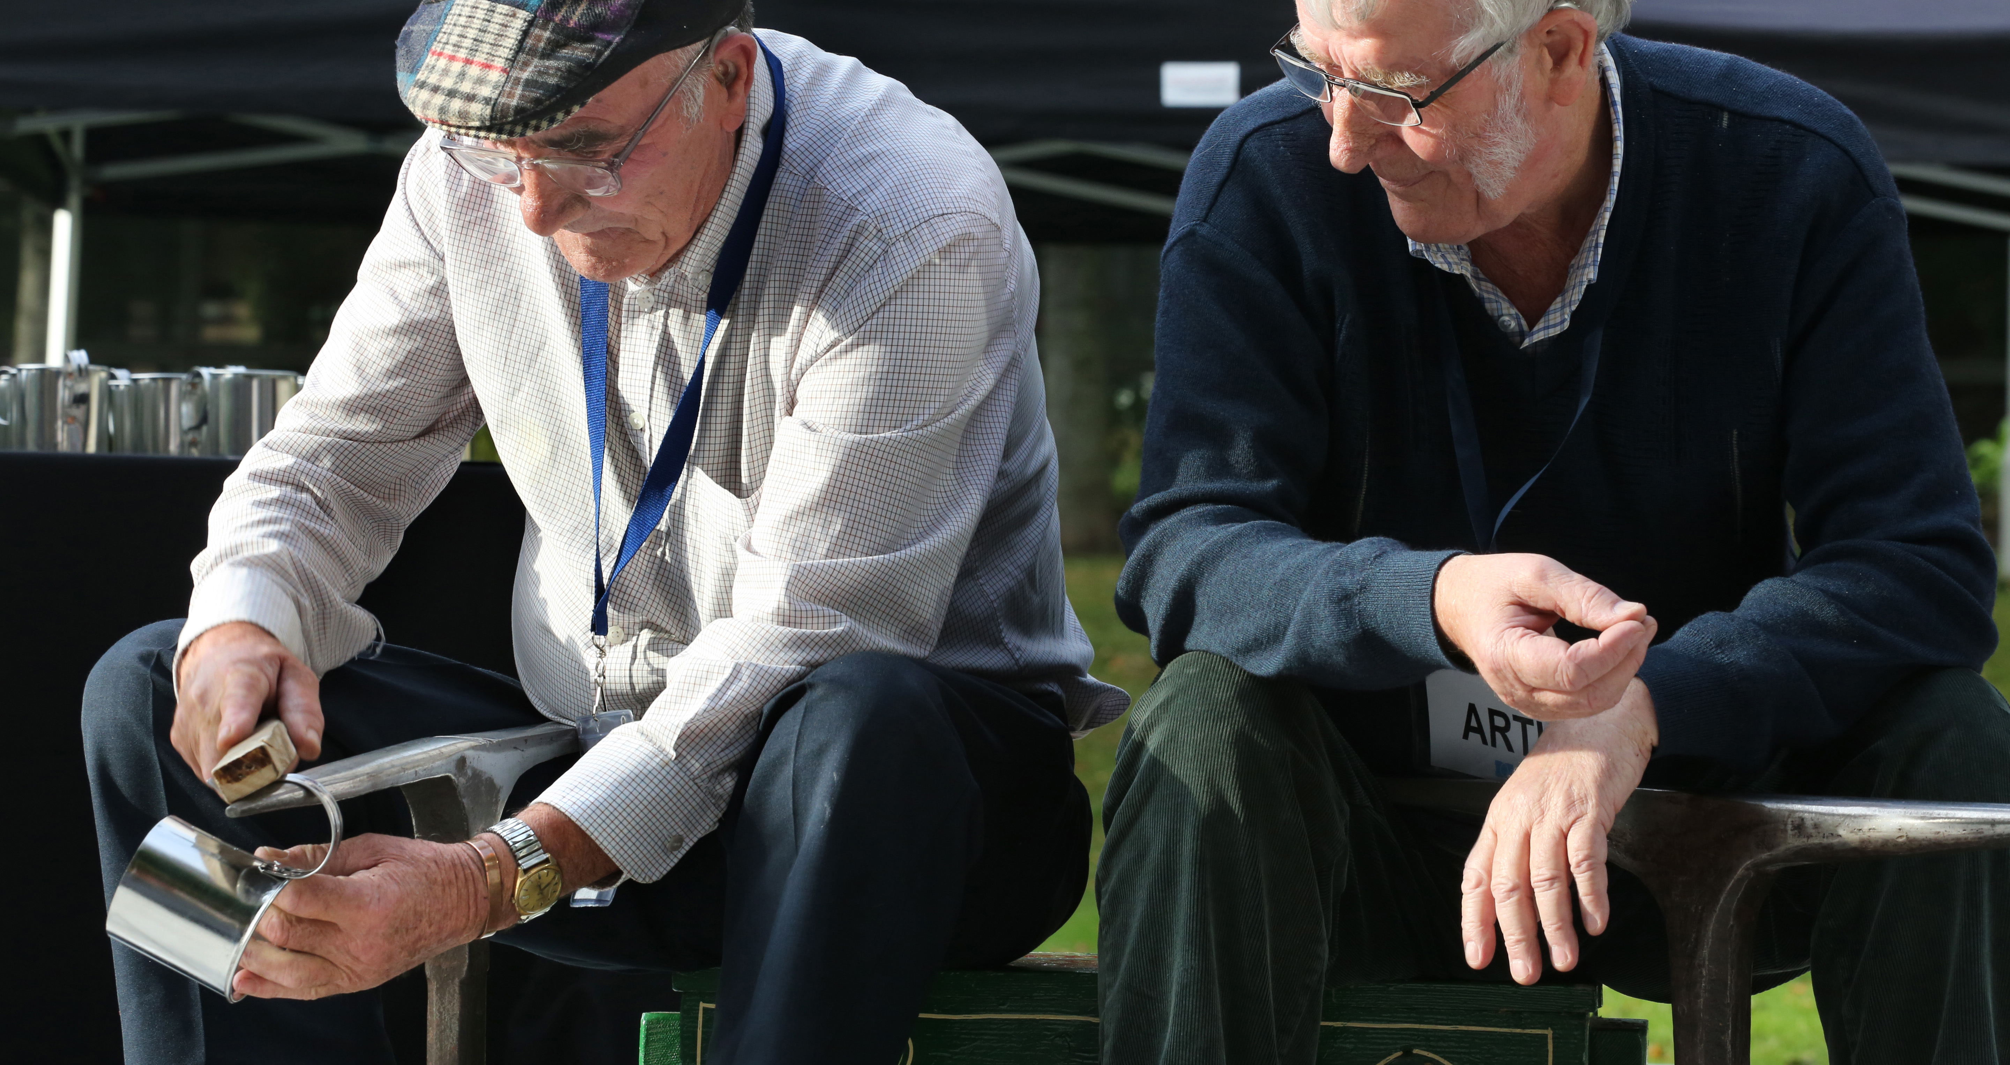
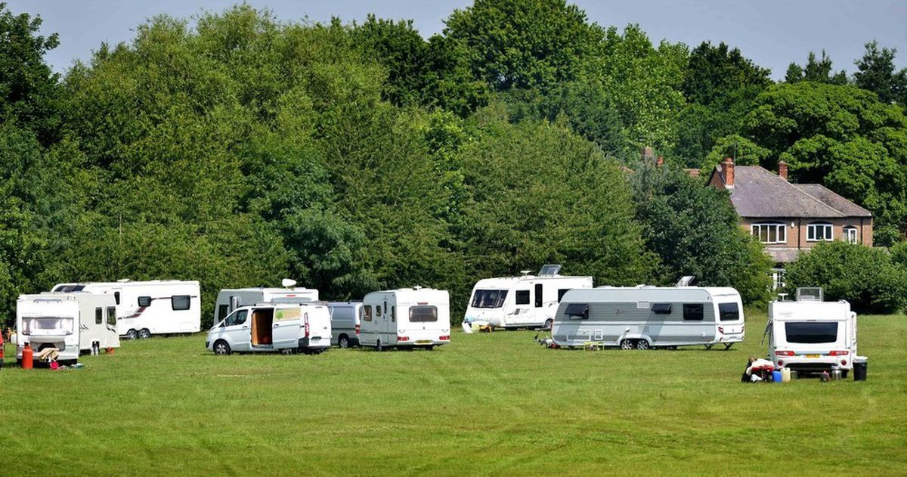
Culture and Traditions
Notes:
Horse trading has always been important for Irish Travellers and Gypsies. There are many Summer horse fairs in Britain and Ireland. Irish Travellers love to go to these big horse fairs to meet family and friends and buy and sell all sorts of things not just horses.
The most famous horse fairs are at Appleby in Cumbria, and Stow on the Wold in Gloucestershire. Each place has one fair a year. There is a famous horse fair in Ireland called Balinasloe.
Some Traveller children who are only 6 or 7 own and trade horses at the fairs. The horses race up and down, this give the Travellers a chance to show off their skills and so horse buyers can see how good the horses are before they buy them!
The pictures are from Appleby Fair. The horses are washed in the river, so they look clean before they are sold. Many Irish Travellers that still own old painted wagons take them to Appleby and other fairs to show them and to re connect with the travelling tradition of the old days. Traveller Tinsmiths (LtoR) James Collins and Tom McDonnell ©Photo by Derek Speirs

Slide 28
GATE Herts Suite G5 Cuffley Place, Sopers Road, Cuffley EN6 4SG
Contact 01707247088
Website https://gateherts.org.uk/

Slide 29
" An overview of the challenges and barriers to good health faced by Gypsy Roma Traveller communities“
- Dr David Smith – Reader in Social Policy
David.Smith1@aru.ac.uk
- Professor Margaret Greenfields – Professor of Social Policy,
Faculty of Health, Education, Medicine and Social Care
Anglia Ruskin University
Margaret.Greenfields@aru.ac.uk

Slide 30
Terminology used in this Presentation
Gypsies (Romani Gypsies) - exonym - (created by others and very widespread in UK policy terminology – does not carry the same racist connotations as does the term in mainland Europe
Travellers (exonym) – in the UK context (ethnic groups) consist of Irish (Pavee or Minceir) and Scottish (Nakin) Travellers but also includes New Travellers (who are not an ethnic group but may now be in their second or third generation of Travelling) . Until relatively recently and to some extent now some English (Romani) Travellers will still refer to themselves as English or Welsh Travellers
Roma – used in policy terms to refer to European Roma, Sinti and related communities who have predominantly migrated to the West (in this context the UK) since the 1980s

Slide 31
Setting the Scene
2021 UK Census records a significant undercount in G/T population enumerating 67,768 persons/head of household identified as from these populations. (nb: 2011 census figures equates to a minimum undercount of 54% based on GTAA evidence see further TM, 2013).
Inclusion of Roma as a census category for the first time – 100,981 enumerated (Brown et al, 2013 estimated closer to 200,000).
Average life expectancy of G/T populations in the UK has been estimated variously as 10-12 years below that of ‘other’ White British citizens (Parry et al, 2004). Baker/Leeds REC (2006) calculated an average life expectancy of 50 years and Bedfordshire NHS Health Trust (2010) around 65 years which broadly mirrors Irish data (All Ireland Traveller Health Study, 2010) . However see further – UK data, (ONS 2012; Cemlyn et. al., 2009; WEC, 2019; FRA, 2020 suggesting lower variables in age range with perhaps 7-9 years lower life-expectancy).
The health status of an average 60 year old G/T person is however similar to the average 80 year old White British person (Watkinson et. al. The Lancet Public Health (2021)

Slide 32
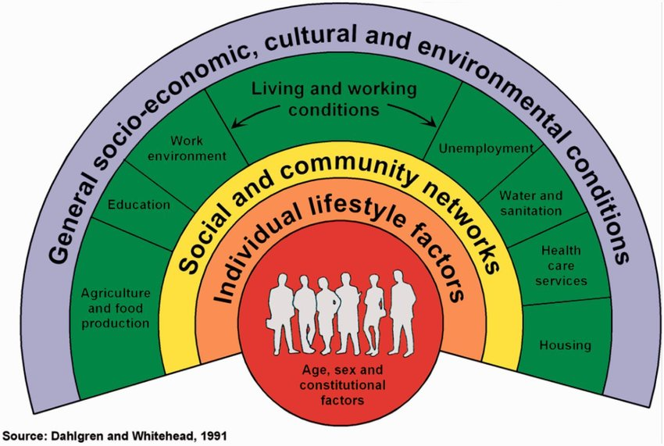
Social Determinants of Health

Slide 33
Contextualising Markers of Social Exclusion
Gypsies, Travellers and Roma are among the most disadvantaged people in the country and have poor outcomes in health and education (UK Government/Women and Equalities Committee, 2019)
Research conducted by the Centre on the Dynamics of Diversity indicated that 62% of Gypsies & Travellers had experienced racial abuse the highest of all minority groups surveyed; 47% of Roma had been racially assaulted and 37% physically attacked (FFT, 2023).
Romani and Traveller communities also have the lowest rate of economic activity of any ethnic group, at 53 per cent, compared with 6.6 per cent for England and Wales overall (ONS, 2021) [no current/comparable data on Roma populations].
ONS (evidence to the WEC, 2019) noted that “the most common reason for Gypsy or Irish Travellers being economically inactive was looking after the home or family (27 per cent v 11% all other English/Welsh residents). Perform the highest levels of unpaid care of 50 hours + per week.
Most common reasons for economic inactivity – caring responsibilities (18%) or due to long term illness or disability (15%) and 1 in 6 Gypsies or Travellers were ‘disabled’ and ‘limited a lot’ in their daily activities by a mental or physical health condition – over double the rate of the general population (FFT, 2023).
See: https://www.ethnicity-facts-figures.service.gov.uk/summaries/gypsy-roma-irish- traveller

Slide 34
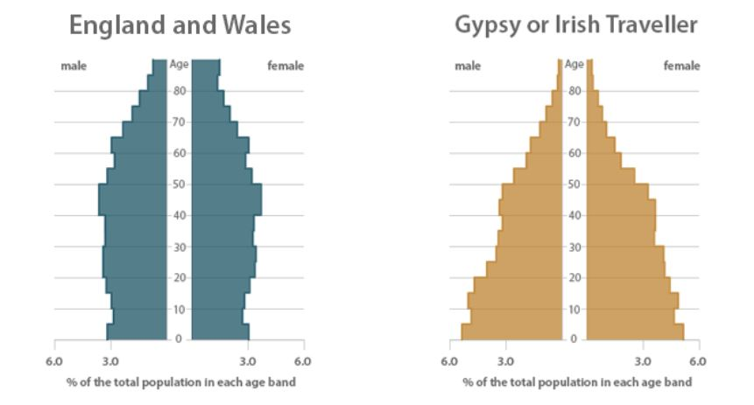
Comparator population pyramid (source ONS, 2019)

Slide 35
General Health Status of the populations
2011 Census analysis (ONS, 2013) found that in England and Wales, Gypsy or Irish Travellers had the lowest proportion of people rating their general health as ‘good’ or 'very good' at 70 per cent compared to 81 per cent overall
Parry et. al. 2004; Cemlyn et. al., 2009; Matthews, 2008; Greenfields, (various dates) evidence premature morbidity; high rates of cardio-vascular disease; over-representation in Type II diabetes; arthritis; asthma and obesity; increasing reports of problematic substance misuse and high rates of anxiety and depression.
Craig, 2011 suggests that the limited research findings pertaining to Roma migrants offer a similar picture (e.g. See too NFGLG, 2014 – report on NRIS in the UK, health review and recommendations; RSG, 2019; WEC, 2019).

Slide 36
FFT (2015) Review of JSNA’s found “a greater prevalence of long-term conditions (42% of English Gypsies are affected by a long-term condition, as opposed to 18% of the general population).
• Considerably higher numbers of smokers in the Gypsy Traveller population (57%) compared to matched comparators (21.5%)”.
Abundant evidence exists (e.g. Parry et al, 2004; Greenfields and Smith – various 2010-2014; Greenfields and Rogers, 2020) of excessive rates of anxiety and depression amongst the communities – particularly amongst women - when compared to other populations.
Depression/anxiety markedly increased on transfer from sites to housing particularly when isolated from family/community (Smith and Greenfields, 2013).
Rogers (2016) found evidence of high levels of repeated – often traumatic or avoidable – deaths within extended families from G/T communities leading to untreated complicated grief and inter-generational trauma.
Thompson et al (2021) confirmed under-use of MH services by Gypsy/Traveller community members (see also Greenfields and Rogers, 2020 for GATE Herts/Report Racism/MHCLG)
.

Slide 37
Maternal and Child Health
Women’s health severely impacted by intersectional exclusion (CoE, 2003; FRA, 2011; FRA 2018; Council of Europe, 2014; EPHA, 2019)
Relatively high levels of perinatal mortality, stillbirth & complications of pregnancy (Hajioff and McKee, 2000; Sheffield Health Study, 2004; Matthews, 2008).
Parry et. al (2004) found 1:5 G/T mothers had experienced the loss of a child (neo- or peri-natally), compared to 1:100 in ‘mainstream’ communities (survey n=293).
The All-Ireland Traveller Health report (2012) found 4x higher childhood death rate amongst Travellers than other populations. RG/T populations (particularly children) experience 100x greater disease burden (preventable infectious diseases than surrounding populations (Maduma-Butshe & McCarthy, 2012).
Low rates of childhood immunisation. NHS England consider that GRT Traveller children are particularly prone to risk as failing to achieve herd immunity (Smith et al, 2016; Greenfields et al 2015; Jackson et.al. 2015; WEC, 2019).

Slide 38
Environmental and Living Conditions
G/T households predominantly live in residential housing (estimated 2/3rds of the population) often in response to lack of adequate pitch numbers) (Greenfields and Smith, 2010-11; ONS, 2013)
Roma overwhelming living in housing – anecdotally often severely overcrowded and poorly maintained (Craig, 2011; Greenfields & Dagilyte, 2018).
Approximately 12% of G/T caravans are not stationed ‘lawfully’ (estimated 2,377, caravans with their residents being technically homeless (MCHLG, 2022) – representing an increase of 13% since 2020 count. Nb: unknown impact yet of the Crime and Policing Act 2022
Impacts of poor quality sites and statutory homeless having a profound and long-term effect on physical and mental health of G/T respondents (Smith & Greenfields, 2013; Greenfields and Brindley: Dept Health commissioned report, TM: 2016; WEC report, 2019; FRA, 2020).
In 2021 – Katherine Quarmby undertook a desk based review of locations of public owned Gypsy/Traveller sites and follow-up interviews. Key findings supported anecdotal evidence that Gypsy/Traveller sites were frequently placed by council tips and recycling centres; sewage stations; busy road and railway lines; industrial estates; cemeteries and slaughterhouses. LA officials emphasised the level of hostility and abuse targeted at populations and objections to planning applications for sites.

Slide 39
Local Authority site in England (photographed by Greenfields whilst undertaking a health assessment)

Slide 40
An unauthorised camp on the outskirts of a city

Slide 41
‘Romani Gypsy bungalows’ in an English city

Slide 42
Barriers to Accessing Healthcare
There is wide-spread and repeated evidence (e.g. WEC, 2019; FRA, 2020; FFT various dates – Mystery Shopper activities etc) of severe and persistent barriers to supposedly universal services for members of Gypsy, Traveller and Roma populations.
Registration (predominantly for mobile/nomadic populations)
Linguistic/Documentation – Roma populations
Impacts of limited health literacy and prior poor experience on community members’ engagement with health services
Lack of cultural understanding (or discrimination) by health professionals.

Slide 43
The Policy Focus – seeking to reduce inequitable access
European Commission National Roma Integration Strategies– 2011 (health included in integration strategy requirements)
2012 – Inter-ministerial Working Group – pledges on health and a focus on working with local health commissioners to ensure inclusion of G/T communities and culturally competent staff
2016 – Inclusion Health Board studies – BNU one of a very limited number of HEIs/training providers embedding GTR issues into some nursing provision
2019 – WEC report – stringent recommendations on health inclusion and inclusion of the communities in JSNA
2019 (June) Sign off of new strategy development by Government – to include recommendations by WEC. Consultation and shape of strategy under development 2020. THEN CAME COVID

Slide 44
Covid 19-21
Limited hard evidence to date on impact of Covid on the communities (cf data issues) in the UK but plentiful anecdotal evidence of challenges for those living on sites; roadside and/or Roma in housing.
Language barriers
Literacy challenges/Digital Exclusion
Experiences of racism/discrimination
Evictions = postcode lottery with some LAs continuing to evict sites despite ban on evictions during lockdown (FFT submission to Public Services Committee Inquiry ‘Public services: lessons from coronavirus).
Hygiene/water/waste disposal for people self-isolating and number of LAs lack of support in accessing during lockdown (FFT submission)
Anecdotal reports of early deaths from Covid (nb – unsurprising re: risk factors cited above re poor conditions on some sites, higher respiratory conditions; over-crowding etc)

Slide 45
Responses to Covid (2019-20)
Rapid community/NGO responses to the crisis re guidance to community members and reaching out to LAs etc.
Scotland and Wales moved more swiftly than England – re in reach from public policy and health staff and close working with NGOs e.g. https://www.facebook.com/GypsyTravellers-Scotland-Public-Information-Service-100442048272006/
https://gov.wales/guidance-those-supporting-gypsy-and-traveller-communities-covid-19-html
Preliminary research into experience of Welsh GRT communities and Covid (2020) http://www.romaniarts.co.uk/the-impact-of-the-novel-coronavirus-pandemic-upon-romani-and-traveller-communities-in-wales-2020/

Slide 46
Collaboratively working with Communities
NGO’s hold an important role as mediators, support workers and providers of advice in relation to health access and debunking concerning myths (eg – Covid vaccinations causing sterility).
Trusted health professionals who are able to build up long-term relationships with local communities and undertake co-production activities in relation to service delivery (e.g. through employing and working in a meaningful way with community member colleagues) are able to clearly evidence increased rates of immunisation, screening, more rapid referrals and reduction in A&E use (see too McFadden et al, systematic review, 2019)
Nb: Some evidence of increased rates of take-up of integrated social care services for disabled and older relatives once trust has been built by ‘cultural translation’ between trusted NGO staff and statutory services.

Slide 47
EU FRA study into local Roma integration. Use of Participatory Action Research to identify relevant local health issues and dialogue between the community and health practitioners (Smith, 2018).
Dyson et al (2020) trusted GP practices, specialist frontline workers and flexibility in wider NHS systems are key to improving immunisation uptake
Co-production and use of peer health navigators can be evidenced as supporting increased rates of immunisation uptake – (nb research undertaken prior to/does not engage with vaccine hesitancy which emerged during the Covid pandemic.
Covid vaccine uptake – anecdotal evidence (supported in EU context) by use of civil society and NGO peer health navigators and use of multi-media resources to encourage take-up and reduce concerns.

Slide 48
Good Practice and Breaking Down Structural Barriers
BANES – CCG commissioned follow-up outreach service to GRT/Boaters following 2013 study (Greenfields et al,) using specialist experienced staff. (Service renewed 12/2015; 2018; extended 2019) – see further: https://www.qni.org.uk/2019/08/29/community-practitioners-championing-health-inclusion-for-forgotten-populations/
Doncaster practice – use of health ambassadors from Gypsy communities; longer appointments; opportunistic screening/immunisations, hand-held medical records for nomadic travellers, flexible appointments: Immunisation levels 4% in 2003 to > 70% 2014. 2004, 0% cervical smear tests, 55%, 2014. http://www.gponline.com/gps-improve-healthcare-travellers/article/1325098

Slide 49
Opportunistic screening and ‘pop-up clinics’ (community outreach) has been effective in identifying GRT populations at risk enabling onward referral (Wrexham health study – cardio-vascular disease and diabetes screening, Robert et. al. 2007; Bristol Roma immunisation scheme; screening at Gypsy ‘horse fairs’ e.g Appleby, etc. 2016-2019). Edinburgh ‘Keep-Well’ scheme/NHS Lothian found dedicated health workers going onto sites and roadside encampments to work with local Travellers identified/reduced risk factors substantially:
Durham has funded community health advocates (from within GRT communities): https://www.youtube.com/watch?v=et7zqedtEY0 (2015->)
Tailored maternity services (including on-site drop-ins and translator availability at Roma outreach groups) supported by Gypsy/Traveller health advocates have proved effective in improving outcomes for GRT populations. (Bennett, 2013) http://www.dmu.ac.uk/documents/business-and-law-documents/research/cchr/sarahbennettintegratedcarepathwaysfortravellersinleeds.pdf nb: follow up protocol on review of post-Covid access to maternity services under development (2022)

Slide 50
Integrated Care….. Commissioning and Delivery
NHS guidance pertaining to this relatively new terrain issued July 2022
https://www.england.nhs.uk/publication/integrated-care-systems-guidance/
Breaking down barriers can be developed through collaborative design and commissioning – use of data and goodwill….

Slide 51
QUESTIONS????
THANK YOU FOR LISTENING !!

Slide 52
An overview of the challenges and barriers faced by the Gypsy Roma Traveller (GRT) communities in Hertfordshire and the UK Please Tweet using #hertsphconnect
Break for 10 minutes….please re-join us at 11.20am You are welcome to add a question to the ‘chat’ during this time

Slide 53
Gypsy, Roma and Traveller (GRT) Mental Health and Suicide Prevention Project:
Qualitative Evaluation
Martin Logue, Senior Research and Evaluation Officer, Public Health Hertfordshire County Council
Martin.logue@hertfordshire.gov.uk
www.hertshealthevidence.org

Slide 54
Contents
Background - Context
Aim
Objectives
Methods
Demographics
Findings
Recommendations

Slide 55
Suicide rates in the GRT communities are more than six times higher than in the general population. (Parry et al, 2004; Sweeney and Dolling, 2020).
Currently, one in four adults and one in ten children from the GRT communities in the UK have diagnosable mental health problems (ONS , 2022).
NHS England acknowledged that populations such as the GRT communities have faced significant health inequalities in the past
A co-production approach with communities such as the GRT community is a key factor to understanding health inequalities and providing services to support physical and mental health (NHS England, 2022)
Background - Context
Part of the Mental Health and Suicide Prevention project for Gypsy, Roma and Traveller communities in Hertfordshire
Conducted by Sukhi Khattran, Health Improvement Co-Ordinator, Public Health, Hertfordshire County Council.

Slide 56
Aim
The aim of the qualitative evaluation was to gather feedback from the Gypsy, Roma and Traveller communities to help shape future mental health and suicide prevention services in Hertfordshire

Slide 57
Evaluation Objectives
The main objectives of this evaluation were to:
Collect
Collect qualitative data to inform planning of services and support for the GRT communities
Understand
Understand the perceptions and experiences of the GRT communities around mental health, wellbeing and suicide
Foster
Foster trusting relationships between the GRT community and other partner organisations including HCC
Increase
To increase confidence of community members, the working group and other organisations involved in mental health and bereavement services within Hertfordshire

Slide 58
Methods
A qualitative evaluation approach was conducted to satisfy the aim and objectives of the project
Qualitative methods included semi structured interviews/focus groups which were conducted face to face or via WhatsApp. The face-to-face interviews were conducted at GATE Herts (Autumn 2022 – Winter 2023)
Demographic data was collected from the participants involved in the interviews/focus groups
All the interviews/focus groups were recorded and transcribed. Thematic and Storytelling approaches were used to analyse the data.

Slide 59
Co-production
The interviews and focus groups would not have been possible without adopting a collaborative approach with GATE Herts
GATE Herts recruited the interview participants, hosted and facilitated the interviews
The evaluation documentation was reviewed by GATE Herts and feedback was suggested to improve the outcomes of the evaluation
Some interview participants preferred to be interviewed by GATE Herts staff.

Slide 60
Demographics
The suggested sample size for the study was twenty participants from the GRT communities (from a wide range of backgrounds - purposive sampling)
Seventeen participants were interviewed (15 face to face; 2 via WhatsApp)
Participants - Fourteen woman and three men
Age range - 18-65 years old
Two participants were disabled, and one was a pensioner.

Slide 61
Demographics
Demographics
AGE RANGE | Housing Status | Gender | Ethnicity | Other | Interview type
60-65 | Private Site | F | Romany | Pensioner | In person
35-40 | Private Site | F | Romany | Disabled | In person
30-35 | Housed | F | Irish Traveller |  | In person
25-30 | Housed | F | Irish Traveller |  | In person
55-60 | Homeless/Roadside | M | Romany | Disabled | In person
60-65 | Housed | F | Romany |  | In person
25-30 | LA Site/ living with parents | F | Mix/IT/R |  | In person
18-25 | LA Site/ living with parents | F | Mix/IT/R |  | In person
35-40 | LA Site | F | Romany |  | In person
18-25 | LA Site/ living with parents | F | Mix/IT/R |  | In person
45-50 | LA Site | M | IT |  | WhatsApp
45-50 | LA Site | F | Romany |  | In person
18-25 | LA Site/ living with parents | F | Mix/IT/R |  | In person
25-30 | LA Site | F | Romany |  | In person
25-30 | Unauthorised site | M | Romany |  | WhatsApp

Slide 62
Themes
Tradition and Culture
Feelings, emotions and beliefs
Modern life, media and perceptions
Physical, mental and social wellbeing
Authorities, councils and organisations

Slide 63
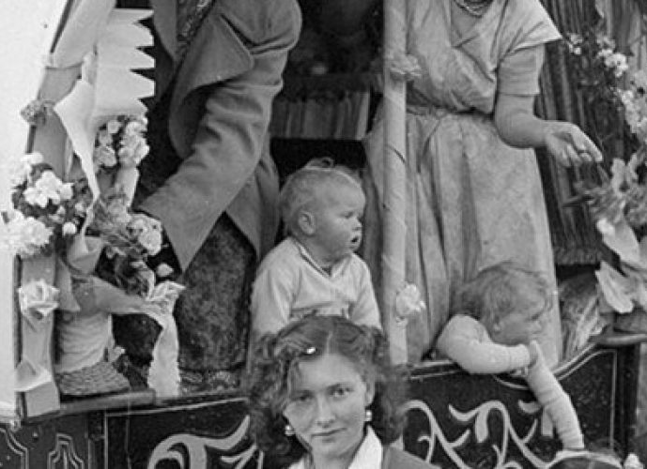
Tradition and Culture
This theme explored GRT traditions, cultures and ways of life and how these have changed or evolved over time including barriers to travelling
Women were seen as having a pivotal role in the communities which meant people would confide in them
Different generational mindsets especially around mental health
Issues of unemployment, societal pressures, and energy poverty. Continued lack of trust in the outside world and a feeling of exclusion from society. Living on sites meant a lack of autonomy on making decisions in many areas.

Slide 64
Tradition and Culture - quotes
“I’ll tell you what depresses them a lot I think, say like you’ve got a mum and dad who’s old school but you’re one that’s growing up that’s not, it’s hard to keep the two. You want to please your mum and dad, but you also want to be your own person” (GRT 1)
“There’s so much and the problem is especially in men, men are burdened with so much responsibility from a young age up until they’re older, so it’s like they carry the weight on their shoulders, but they don’t actually express it to anybody” (GRT 3).
“it’s a part of our DNA that we’re very untrusting, which stems from the way we’ve been brought up, the way we’ve had to be brought up against the world, so there’s got to be a lot more trust, concrete trust that they can speak to someone” (GRT 4).
“It’s heating or eating, there will be a lot of kids going without food this year the way it’s going up, which ain’t good.” (GRT 2)

Slide 65
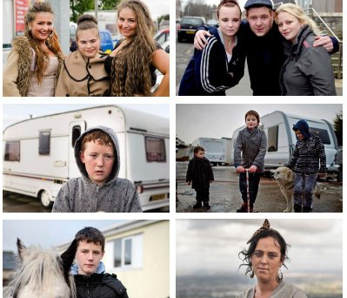
Feelings, emotions and beliefs
A common thread emerged around stigma and prejudice especially in/with men
Discussions around the language of mental health in the communities and the terms that were used to describe low mood
Shock of discovering that a family member had taken their own life was described. Difficulty of talking about mental health and suicide within and families and the wider community, and the preference of talking to a stranger
A lack of communication and understanding from outsiders was frequently mentioned as was the experience of “collective blame”

Slide 66
Feelings, emotions and beliefs - quotes
“Because a lot of them was condemned weren’t they if they killed themselves years ago, people sort of looked down on it a bit didn’t they? Because a lot of people worried about looking, especially men and boys, they think it’s shameful if they’re asking for help from the outside” (GRT1).
“But there’s so many suicide deaths in our culture, there’s been more in the last few years there’s been more young people, old people taking their lives where they bury so much. There is because there’s so much ...Stigma over it” (GRT 3).
“But if you’re not a Traveller you can be a mechanic, you can be a nurse, you can be anything, but as soon as they find out what you are they don’t want to know you. The people don’t give you a chance to find out what you are” (GRT 6)

Slide 67
Modern Life, media and perceptions
Participant’s felt the media portrayal (including social media) and perceptions of the travelling communities were untrue, negative, and stereotypical. GRT communities struggled with literacy, digital poverty, and exclusion.
Which social media platforms were used by what age group. Raising awareness around wellbeing through the use of leaflets, posters and other platforms.
The use of social media by the different generations and how it is used as an educational tool
Notes:
Living in a modern society including the challenges of the digital world.

Slide 68
Modern Life, media and perceptions – quotes
“Like TikTok and Facebook and things, I think the younger ones are more TikTok and Instagram isn’t it than Facebook”
“..but if I didn’t have that self-referral, if I didn’t know how to do that, you see I can read and write, but there’s a lot of people ... I can access the Internet or whatever, there’s a lot of people that can’t” (GRT 2)
There’s more men on the Facebook looking at it than there is women” (GRT 1)
I think a WhatsApp group is another thing as well, I think because you can make it like it’s a, it’s like a group of friends rather than someone being your counsellor” (GRT 1)

Slide 69
Recommendations
Education – GRT awareness at educational bodies i.e.. Traveller awareness week in June
Cultural competency - training for organisations in Herts. HCC, Schools, businesses, NHS (Safe Surgeries - Doctors of the World)
Activities – Needs to be age dependant; coffee mornings, sport, horses, self care etc
GRT champions and Liaison role - Using a co-production approach
Social media campaign – Mental health awareness campaigns using Facebook, TikTok, Instagram
MH services - Phone and face to face options
Green and community spaces – Youth clubs, Men’s clubs and community clubs
Literacy training and upskilling workshops
Set up a healthcare hub in Hertfordshire
Energy and fuel poverty – National and local government organisations need to take steps to reduce energy inequality.

Slide 70
Accessing Primary care
Experiences of Romany Gypsies, Travellers & Roma.

Slide 71
My background

Slide 72
Nationally
Mothers are 20x more likely to have experienced miscarriages, still births and neo-natal deaths.
Life expectancy is 12 years lower than the rest of the population.
Mental health: 3x more likely to suffer from anxiety, x2 more likely as to suffer from depression and suicide is six times higher.
*Stats are usually worse and not better for those in the community that are in bricks and mortar housing.

Slide 73
A hidden problem
A SystemOne database search based on ethnicity identifies just 38 persons registered at a surgery who are Gypsy/Romany, Traveller or Irish Traveller.
A database search using site postcodes identifies 111 likely Gypsy/ Roma /Travellers persons registered at the practice.
How many remain unregistered?
Many more in housing….

Slide 74
Locally….
Uptake of cervical screening locally….. 90%
Gypsy and Traveller community…….25%
Uptake of MMR vaccine locally……85%
Gypsy and Traveller community…….25%
Uptake of Health checks locally…….60%
Gypsy and Traveller community…….15%

Slide 75
Factors affecting health
Site locations
Eviction stress
Education & Literacy levels
Mistrust of health professionals
Discrimination from health personnel
Digital exclusion

Slide 76
Factors affecting Health cont
Health beliefs
Poverty
Smoking and alcohol use
Poor immunisation uptake
Not accessing health screening
Unable to register at GP surgery

Slide 77
Case study 1
J lives on a site with one mail box. His bowel screening kit has been sent in the post.
There are 5 males on the site with the same name.
J never receives the kit and explains that literacy is poor and so the recipient was unlikely to know what it was.

Slide 78
Case study 2
A is pregnant and wants to make an appointment to see a midwife.
She is told she needs to complete an online form in order to be given an appointment.
This requires a device, wifi, an email address, digital literacy…

Slide 79
Case study 3
A is a Roma Gypsy from Hungary.
She is offered a Hungarian interpreter who upon realising she is a Roma Gypsy becomes racist and rude towards her.

Slide 80
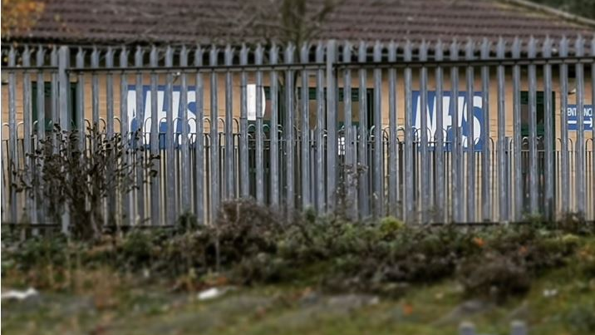
Hard to reach communities or hard to access services?

Slide 81
An overview of the challenges and barriers faced by the Gypsy Roma Traveller (GRT) communities in Hertfordshire and the UK Please Tweet using #hertsphconnect

Slide 82
thank you for joining us today
Herts Public Health Connect Master Class Series
We will notify you when the presentation materials from today’s event are available
Tweet today using #hertsphconnect

