Slide 1


Public Health Evidence & Intelligence:
Joint Strategic Needs Assessment (JSNA) Team
Collaborative Working
May 2023
www.hertshealthevidence.org
Notes:
Thank you for your time joining today’s PH Knowledge and Skills session.
We hope you find this a useful summary of the work of the Evidence and Intelligence staff within Hertfordshire Public Health.
We are starting with a question - ‘how do YOU use data and evidence on health and wellbeing to improve your services’. As you listen to the examples, we hope you will reflect on your projects, your teams and your stakeholders, and think about how you find data and evidence, and how you analyse and evaluate evidence to improve the services that you deliver.
We hope you will also find out about some services and opportunities that could help you which you weren’t aware of before.
------
Hi everyone. I’m Vicki and I’m a member of the Joint Strategic Needs Assessment (JSNA) team with a joint role between Public Health Evidence and Intelligence and Community Protection. I am co-presenting today with our Drug and Alcohol Analyst, Becki, on how the JSNA team work collaboratively with stakeholders to produce effective and impactful JSNA products.

Slide 2
What we are talking about today
Overview of the JSNA
How we collaborate with stakeholders
JSNA working groups
Joint working with community safety
Joint working around drugs and alcohol
www.hertshealthevidence.org
Notes:
In today’s session we are going to cover a range of topics related to our collaborate working with other teams.
We will start by giving you an overview of the Joint Strategic Needs Assessment (JSNA) and the types of products that we create
We will then give you an overview of how we collaborate with stakeholders, both internal and external
Followed by some information on our new JSNA working group process
Finally, we will then give you some information on our joint working with the County Community Safety Unit
Followed by specific examples of our joint working around drugs and alcohol

Slide 3



What is the JSNA?
Hertfordshire's Joint Strategic Needs Assessment (JSNA) looks at the specific health and social care needs of our local population and highlights areas of inequality. It helps public bodies decide what type of local services to commission.
The JSNA comprises a variety of needs assessments, each looking at a different issue. They are regularly updated to reflect the changing needs of the local population.
www.hertshealthevidence.org
Notes:
Becki: The Joint Strategic Needs Assessment (JSNA) is a statutory obligation that aims to improve the health and wellbeing of the local community by identifying the specific health and social care needs of the local population and highlighting areas of inequality. This could be health inequalities that exist between different groups, for example ethnic groups or age groups, or it could be health inequalities in different locations. The JSNA is then used by public bodies to help inform commissioning decisions.
There is no standard format nationally for what a JSNA looks like, but here in Hertfordshire we produce a number of different JSNA reports with each one looking at a separate issue. JSNAs are then regularly updated using a prioritisation process and this allows us to ensure that we are identifying the changing needs of the population.
The JSNA is the responsibility of Hertfordshire’s Health & Wellbeing Board and the Public Health Evidence and Intelligence team undertake the JSNA process on their behalf.

Slide 4
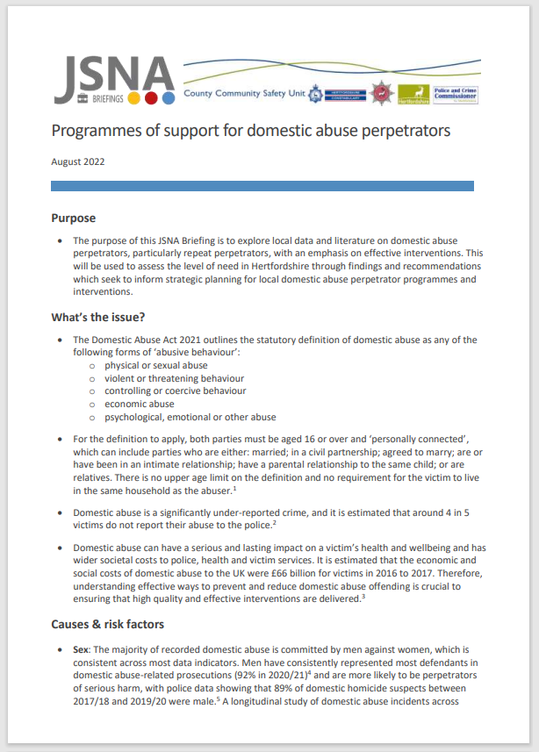
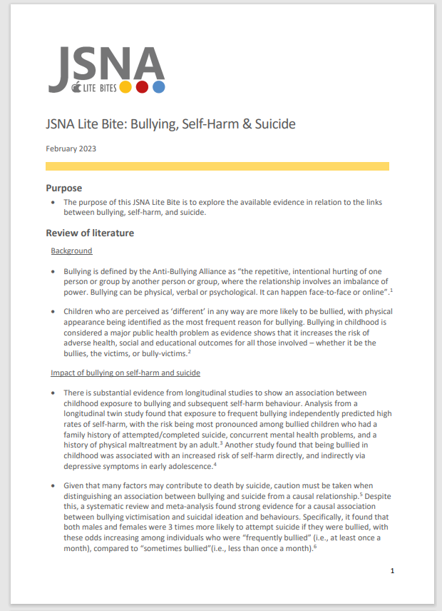
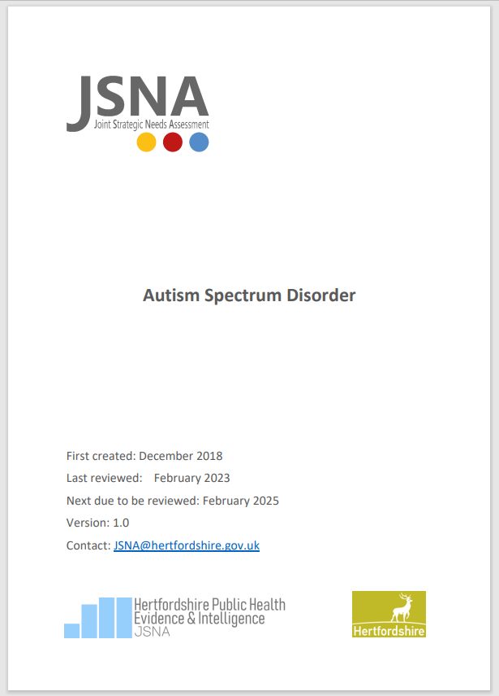

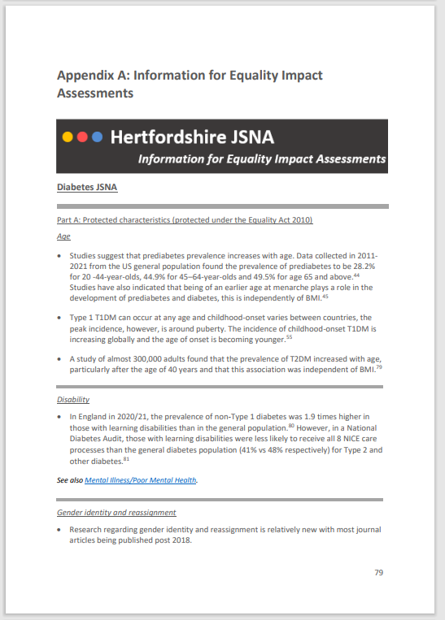
What do we do – JSNA products
JSNA products:
JSNAs
JSNA-on-a-page
and accessible version
Information for EqIAs
Case Studies
JSNA Briefings
JSNA Lite Bites
Infographics
Bespoke requests (£)
www.hertshealthevidence.org
Notes:
Becki: Some examples of the JSNA products we can offer include the full statutory JSNA, smaller briefings, or our rapid literature review litebites. The team also works on producing snapshot products such as infographics or our summary JSNA on a page documents, which provide a brief, eye catching overview of any given public health topic. We also work with both internal and external stakeholders across the county on bespoke, paid for requests that may cover a much more specific health topic or the general health and social care needs of a district within the county, for example.

Slide 5
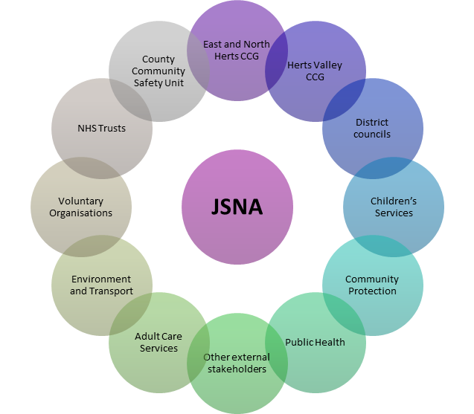
Collaborative working with stakeholders
  The JSNA team work collaboratively with a range of stakeholders, both internally and externally
  The team work with stakeholders to identify datasets that can be used within JSNA documents, understand local strategies and services related to the topic, and ensure that information is accurate and up-to-date
  JSNA team sometimes collaborate on JSNA projects with other teams, such as the Behaviour Change Unit (BCU) and Community Protection
www.hertshealthevidence.org
Notes:
The JSNA team work collaboratively with a range of stakeholders, both internally and externally when producing JSNA products.
The team work with stakeholders to identify datasets that can be used within JSNA documents, understand local strategies and services related to the topic, and ensure that information is accurate and up-to-date. Some examples of key stakeholders can be seen in the image on the right side of this screen.
We also sometimes collaborate on JSNA projects with other teams, such as the Behaviour Change Unit (BCU) and Community Protection. For example, last month we collaborated with the BCU and other teams within Public Health to produce a JSNA on barriers to COVID-19 vaccine uptake among the immunosuppressed population, which is currently being used to target interventions for increasing vaccination uptake among this population.

Slide 6
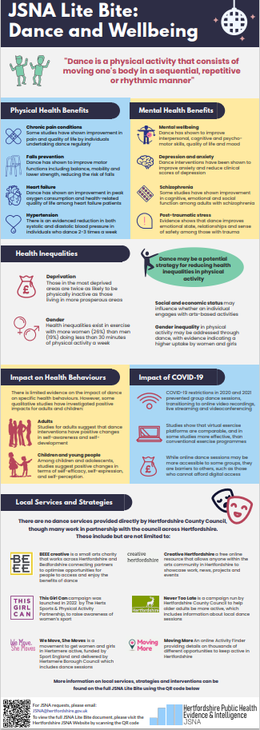
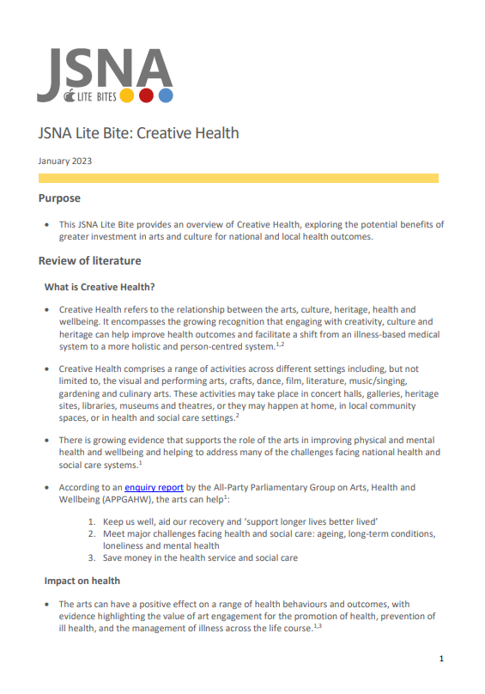
Collaborative working with stakeholders
Online JSNA request form
We work with stakeholders to provide them with the information that they need in the most suitable format for their audience
We recommend products most suitable for the requirements of the request
Can also provide visual summary products, such as infographics (£)
www.hertshealthevidence.org
Notes:
The JSNA team have an online request form on our JSNA website which we ask people to complete when requesting products in order to provide detailed information on their request, their intended audience and desired outcomes of the request. This helps us to work with stakeholders to understand their needs and requirements, and provide them with the information that they need in the most suitable format for their audience.
We can also recommend the most suitable JSNA products for the topic in question. For example, if the request is for a niche topic, or requires a rapid literature review, we may recommend a JSNA Lite Bite or Briefing, whereas for more detailed and complex topics we may suggest a full Joint Strategic Needs Assessment.
We can also provide visually engaging products, such as infographics, as an add-on to accompany JSNA products and summarise more complex information. An example of an infographic we produced for our Dance and Wellbeing JSNA Lite Bite can be seen on the right side of the screen. Please note however that bespoke infographics usually come at an additional cost, so please enquire with the JSNA team if you would like to request an accompanying infographic or other add-on product.

Slide 7

JSNA working groups
  The JSNA team now use working groups for new and more complex JSNA topics that require a range of knowledge and expertise
  Working groups are chaired by the JSNA team and consist of a range of internal and external stakeholders appropriate to the topic
  Working groups work through JSNAs section by section and assist with providing expertise, data and information on local services where required
www.hertshealthevidence.org
Notes:
Becki: The JSNA team now use working groups for new and more complex JSNA topics that require a range of knowledge and expertise
Working groups are chaired by the JSNA team and consist of a range of internal and external stakeholders appropriate to the topic
Working groups work through JSNAs section by section and assist with providing expertise, data and information on local services where required

Slide 8


Joint working with community safety
  2 co-located analysts based between the County Community Safety Unit (CCSU) and JSNA team
  Promotes joint working on topics which overlap health and community safety (e.g. substance misuse and mental health)
  Develops ability to explore links between health, crime and exploitation and make multi-agency recommendations to address underlying causes and risk factors of the issue
www.hertshealthevidence.org
Notes:
The JSNA team have 2 co-located analysts based between the County Community Safety Unit and the Public Health JSNA team – a Senior Community Safety Analyst and a Drug and Alcohol Analyst. The CCSU sits under the Community Protection Directorate in HCC and consists of a co-located team of police and HCC analysts and Programme Managers.
This arrangement has helped to promote joint working between both teams on many topics that overlap health and community safety agendas, for example substance misuse and mental health. It has also developed our ability to explore crime and exploitation as wider determinants of health, and vice versa to examine health-related risk factors for crime and exploitation. We make multi-agency recommendations within our joint products to encourage collaborative working across organisations to address the underlying causes and risk factors of the issue.

Slide 9
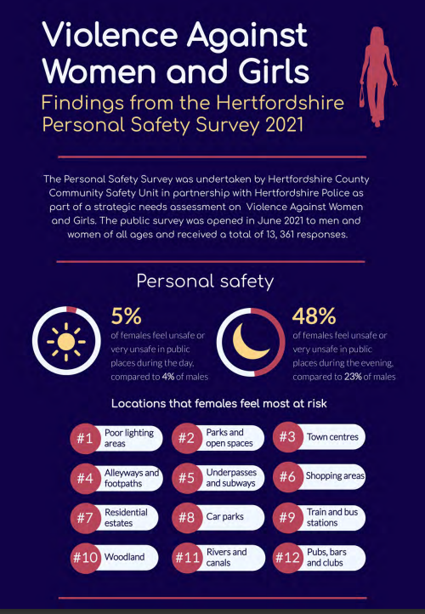
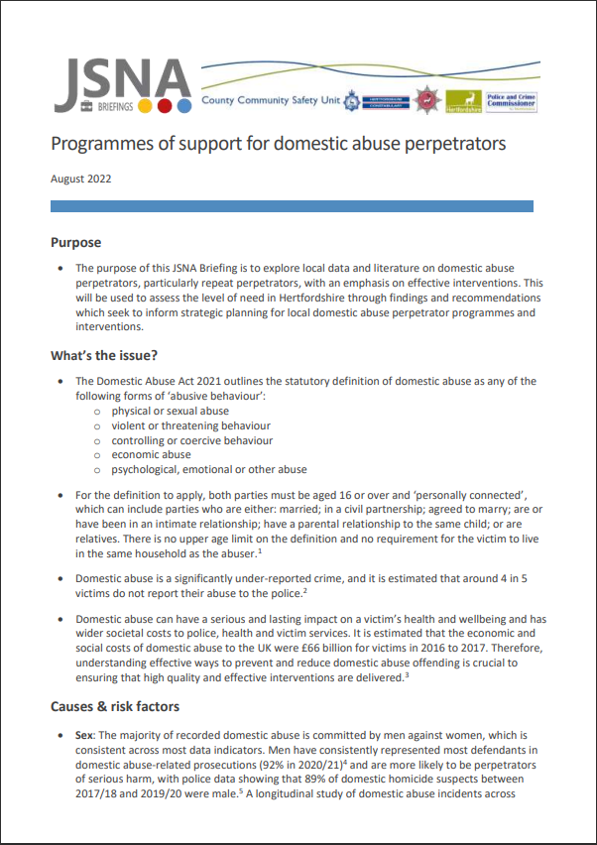

Examples of joint products
  Modern slavery (currently updating)
  Violence Against Women and Girls
  Asylum Seekers and Refugees
  Demand of Mental Health on Local Services
  Serious Violence
  Domestic Abuse
  Effective programmes for domestic abuse perpetrators
  Drugs and Alcohol
www.hertshealthevidence.org
Notes:
This slide outlines just a few examples of some of the joint products which have been produced in collaboration with the CCSU. These include:
Modern slavery JSNA (which is currently being finalised and due to be published later this month)
Violence Against Women and Girls needs assessment, in which we undertook a public survey of Hertfordshire residents to understand feelings of personal safety among women and girls
Asylum Seekers and Refugees JSNA Briefing to understand challenges faced by asylum seekers and refugees
Demand of Mental Health on Local Services needs assessment, which expands on the Mental Health JSNAs and focuses on the demand mental health has had across a range of local organisations
Serious Violence needs assessment, which examines data from a range of organisations on the most high-harm forms of violence, such as knife crime
Domestic Abuse needs assessment, which includes issues such as stalking/harassment and children witnessing domestic abuse in their home
JSNA Briefing examining evidence on the most effective programmes for domestic abuse perpetrators at different levels of risk
Variety of Drugs and Alcohol related products, including the Drug and Alcohol JSNAs, Drug and Alcohol Deaths Audit and a JSNA Lite Bite on Addiction and Criminality. Our Drug and Alcohol Analyst, Becki, will go into some more detail on our joint working around drugs and alcohol on the next slide.

Slide 10







Drugs and alcohol
A grant funded co-located analyst based between the County Community Safety Unit (CCSU) and JSNA team
Leads on the production of drug and alcohol related JSNA products and provides analytical support on topics associated with substance misuse in Hertfordshire
Workload is determined by the D&A workstream leads and covers topics such as criminal justice, detox and residential rehab and children and young people
www.hertshealthevidence.org
Notes:
Becki: From March this year, we now have a designated Drug and Alcohol Analyst which sits jointly between the CCSU and JSNA teams, promoting a joint approach to creating intelligence products on drug and alcohol related issues in Hertfordshire. The purpose of this role is to support the aims of the Drug and Alcohol Strategic Board and encourage evidence-based decision making for the spending of Hertfordshire’s government awarded Drug and Alcohol Supplemental Grant. To achieve this, the role leads on the production of drug and alcohol related JSNA and intelligence products, and provides analytical support on topics associated with substance misuse, most notably aimed at improving the number of people accessing structured drug and alcohol treatment in the county.
The workload is determined through a separate process to standard JSNA products, and requests must be made to the CCSU through the Drug and Alcohol workstream leads, which cover topics such as criminal justice, detox and residential rehab and children and young people, among others.

Slide 11
Positive outcomes from CCSU joint working
  Violence Against Women and Girls (VAWG) JSNA: administered a public survey to understand how safe women and girls feel in Hertfordshire, which reached over 13,000 responses. Findings from this JSNA are being used to develop a partnership VAWG Strategy.
  Effective Programmes for Domestic Abuse Perpetrators JSNA Briefing: used to support a successful funding bid to the Home Office for evidence-based domestic abuse perpetrator interventions which effect behavioural change and encourage healthy relationships.
  Drug and Alcohol Deaths Audit: worked with Coroner’s Service to develop local data on preventable deaths caused by substance misuse. Findings from the audit have been used to target areas for rollout of naloxone to prevent drug-related deaths in Hertfordshire.
  A&E Violent Assault Dataset: captures data on individuals presenting to A&E departments for alcohol and weapon-related violent assaults, many of which are not captured in police data.
  COVID-19: ensured that all joint products examined the impact of the pandemic on the issue.
www.hertshealthevidence.org
Notes:
This slide outlines some of the many positive outcomes we have achieved from our collaborative working between health and community safety.
The first example is the Violence Against Women and Girls JSNA that was undertaken in 2021. As part of this JSNA, we undertook a public survey to understand how safe women and girls feel in Hertfordshire, which reached a total of 13,000 responses. The findings from this JSNA and the survey are being used to develop a partnership VAWG strategy.
We also produced a JSNA briefing last year on Effective Programmes for Domestic Abuse Perpetrators which was used to support a successful funding bid to the Home Office for evidence-based domestic abuse perpetrator interventions which effect behavioural change and encourage healthy relationships.
Following the success of the Suicide Audit, we worked with the Coroner’s Service to introduce a Drug and Alcohol Deaths Audit in 2020 to develop local data on deaths caused by substance misuse, including producing annual reports on these deaths. Findings from the audit have been used to target areas for rollout of naloxone (an opiate overdose reversal drug that can be administered by clinical and non-clinical staff) to prevent drug-related deaths in Hertfordshire.
As a result of the joint working between the CCSU and Public Health, we worked with the NHS Trusts in Hertfordshire to introduce the Hertfordshire Violent Assault Dataset, which captures data on individuals presenting to A&E departments in Hertfordshire for alcohol and weapon-related violent assaults.
During the COVID-19 pandemic, we also ensured that all joint products examined the impact of the pandemic on the issue. For example, the impact that restrictions had on knife crime and people trapped in domestic abuse situations, and the impact of the pandemic on issues such as mental health and substance misuse behaviours which are key risk factors for crime and exploitation.

Slide 12


JSNA
Find out more
For JSNAs, briefings or Lite Bites on a health topic submit a request to the JSNA team, through
www.hertfordshire.gov.uk/jsna
JSNA@hertfordshire.gov.uk
Find out more
www.hertshealthevidence.org
Notes:
Becki: Thanks so much for listening, if you have any questions, please do get in touch using our JSNA email.

